Slide 1
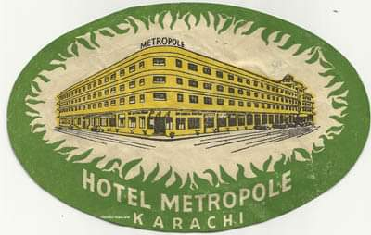
M E T R O P O L E O F K A R A C H I
WHAT CAN WE DO?
By Danish Azar Zuby, September 2019

Slide 2
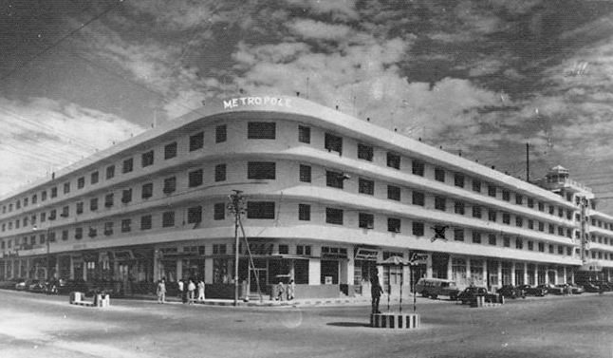
It was one of the only two Luxury Hotels of Karachi of the 50’s. The Palace Hotel (now Movenpick) and the Metropole. Built in the 40’s on a 4 acre rectangular site.

Slide 3
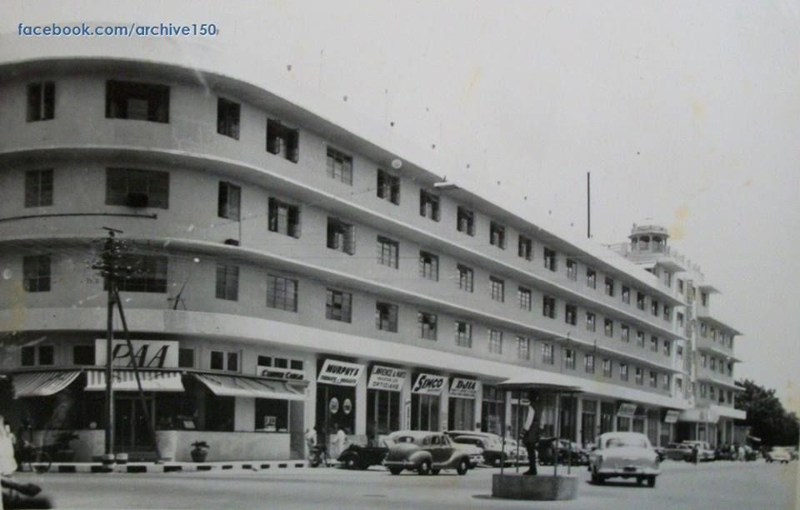
A District that includes State Guest House, Sindh Club, Qaid-e- Azam House, Frere Hall, Governor House, Commissioners House and his offices, Chief Ministers House and his offices among many other Historic Structures
It just happened to be located in the heart of one of
the most important HISTORIC DISTRICTS of Karachi

Slide 4
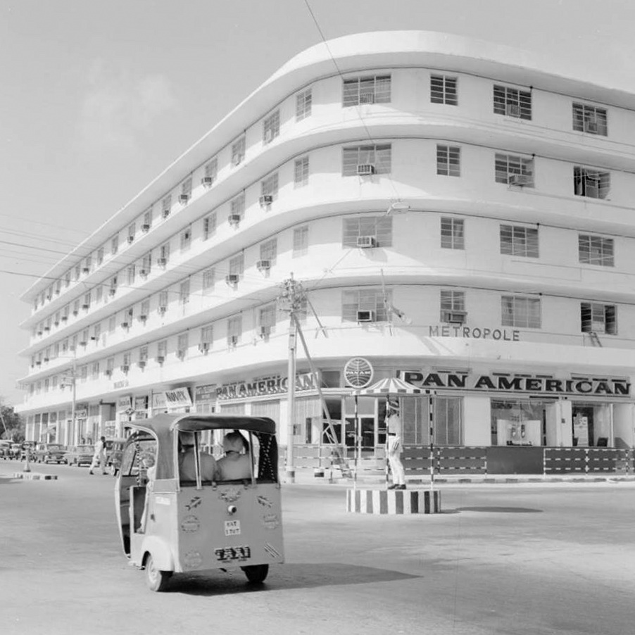
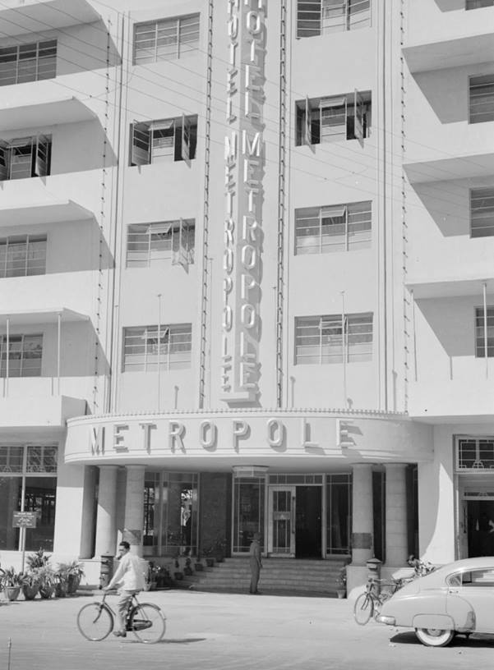
The architectural Design was neat but did not carry any historical significance. The entrances had the ODEON style look. It was a simple Steel and concrete structure with simple straight lines of the projections above windows wrapping around three sides of the façade

Slide 5
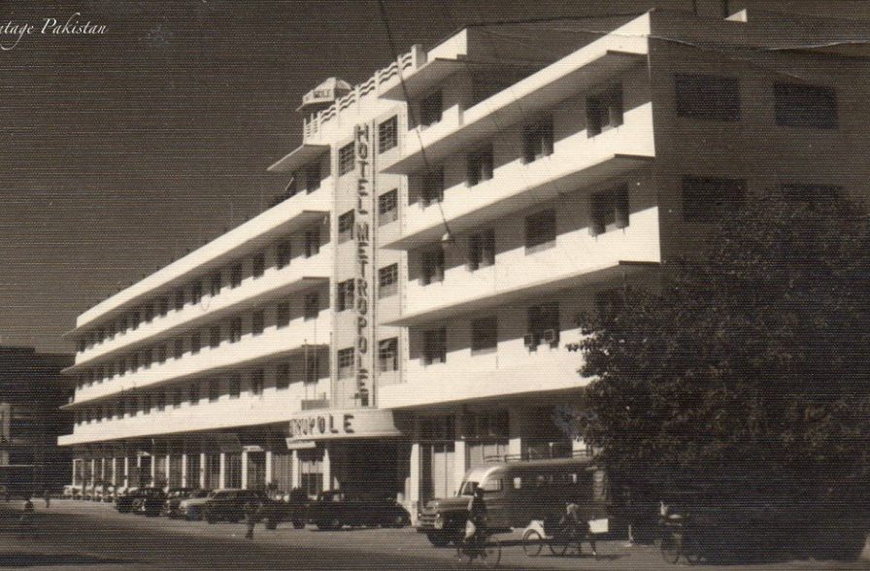
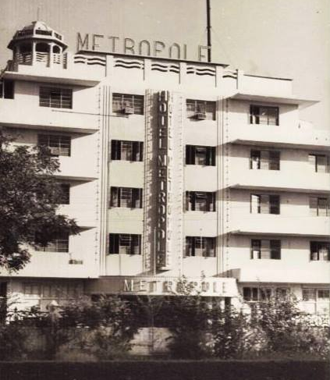
The only distinguishable feature that had some character was the main entrance. This does not exist anymore

Slide 6
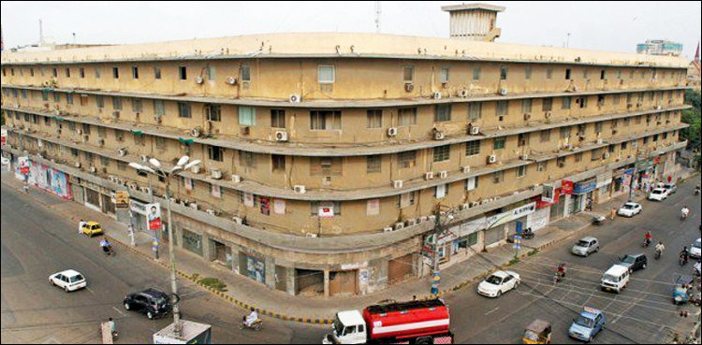
Today the property has become an urban eyesore. This abandoned- dilapidated look is of great concern considering the importance of the locality and presence of high profile government offices in the vicinity

Slide 7
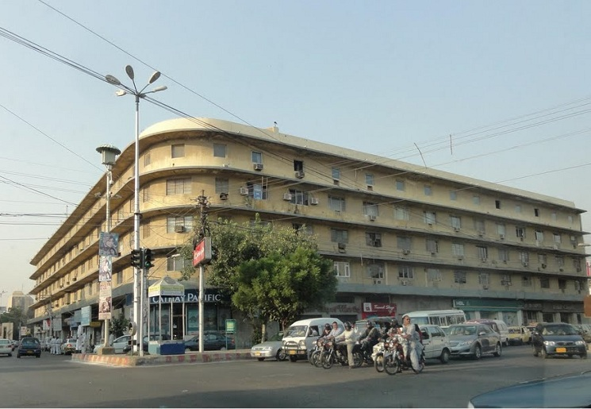
Last year the property was purchased by a business tycoon and announcements were made for a
6 Star Luxury Hotel for this site

Slide 8
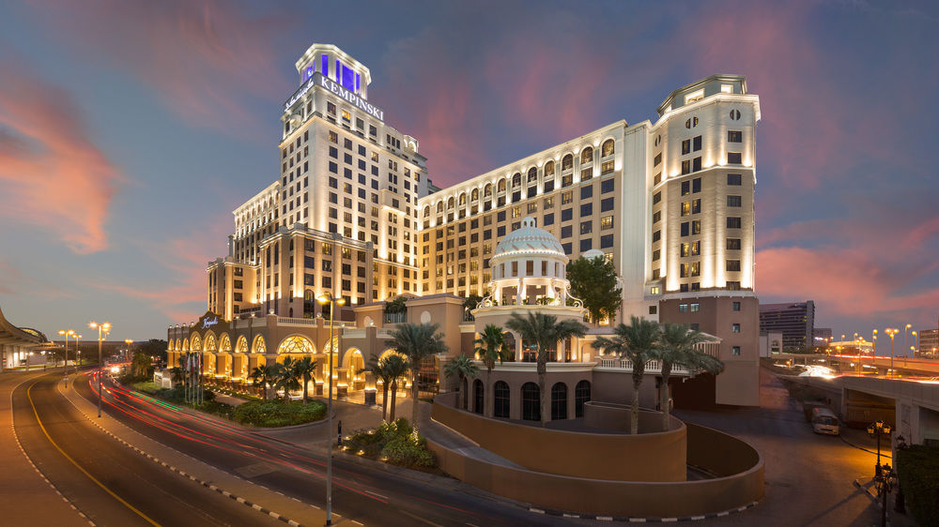
Fantastic Design proposal was shared in the press to turn this ugly abandoned Spot into a high profile locale!

Slide 9
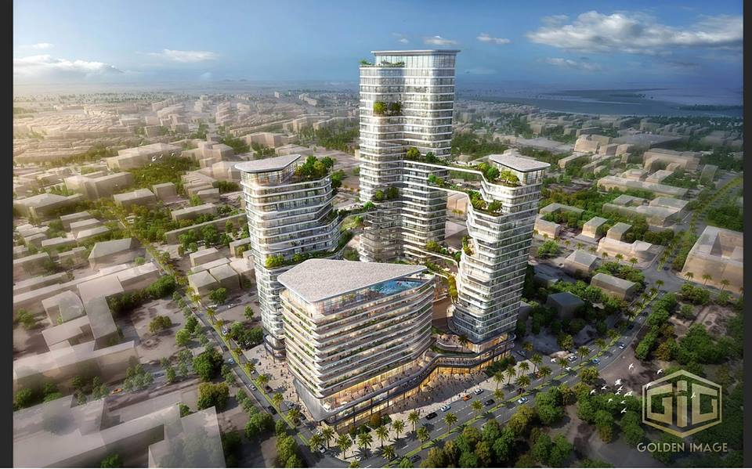
The other Design proposal doing the rounds on-line was of 4 towers which included Apartments and Office Towers besides the Hotel.
These design proposals look awesome
Totally in line with the Neo-Liberal Agenda of creating World class cities for World class business for World class Profit

Slide 10
BUT IS KARACHI READY FOR ALL THIS
With such Projects there will be Hundreds of thousand of CARS and MOTORCYLES added to this very Spot polluting environment and further destroying the already Air Quality standards.
Energy Requirements? Are these projects going to produce their own energy or our ‘God knows who owns’ KE will boost up its supply?
Water? Utilities? Is the existing City Sewerage system ready for all this?
KARACHI HAS ONCE AGAIN HAD THE DISHONOUR OF BEING AT THE LOWEST OF THE LOW – LIVIABLE CITIES OF THE WORLD- SITTING NEXT TO TRIPOLI OF LIBYA AND DAMASCUS OF SYRIA, WAR TORN ZONES
One of the main reasons being Environment Pollution and Air Quality

Slide 11
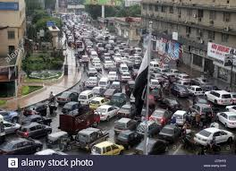
A Contextual and a critical analyses pertaining to the site reveals a few things
Metropole
CONCERN 1: The biggest issue at hand right now is TRAFFIC CONGESTION and the resultant pollution

Slide 12
WHEN A 1000 CARS ARE ADDED TO KARACHI ROADS EVERYDAY THE TRAFFIC IS GOING TO GET WORSE BEYOND REPAIR
TASK NUMDER ONE FOR IMMEDIATE REDRESSEL OF BOTTLE NECKING IS TO EASE OUT TRAFFIC FLOW WITH THE HELP OF SOME TREAFFIC ENGINEERING SOLUTIONS LIKE SIGNAL FREE CORRIDORS ETC. WITH THE HELP OF CONCERNED DEPARTMENT

Slide 13
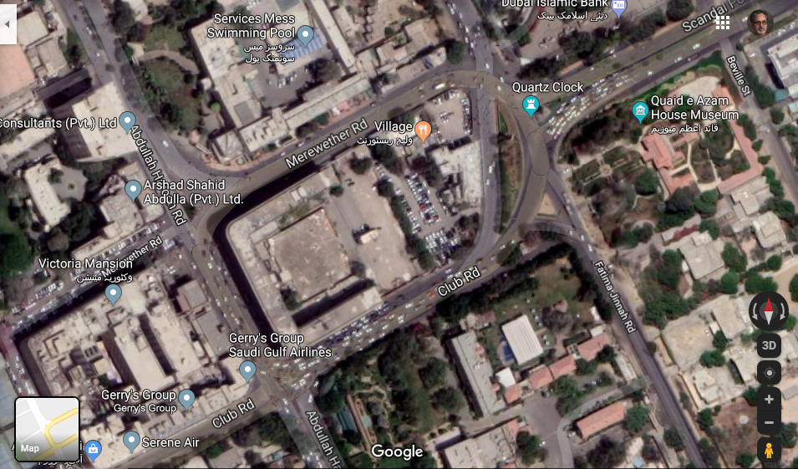
CONCERN 2: THERE ARE HUNDREDS OF OFFICES IN THE NEIGHBORHOOD BUT THERE ARE NO PARKING SPACES. HENCE THE MEREWEATHER ROAD IS CHOKED IN THE DAY TIME WITH HUNDRED OF MOTERCYCLES AND CARS - AS PARKING IS NOT ALLOWED ELESE WHERE.
M E T R O P O L E

Slide 14
About 40% of the Metropole site is being utilized a CAR PARK, which is a great relief for the people visiting this neighborhood everyday
Car Park
Car Park

Slide 15
The recent decision of the Government to acquire the Metropole property and create a Garden is a welcome step for the neighborhood. The following are some issues raised by citizens:
Accessibility issues: As this area is nothing but a traffic nightmare, who would want to approach this park with parking not allowed anywhere close.
Maintenance issues: We have a Frere Hall Gardens only a stones throw from here which has not been maintained up to expectations
Large parks often incorporate sweeping green lawns that require huge inputs of water, fertilizer, pesticides, fuel, and labor. Parks with Lawns become un-sustainable.

Slide 16
Can a public Utility be created here which could help reduce vehicular congestion and also solve the parking problems of the district
While we are at it can we also remember some History of Karachi and celebrate what was Karachi in a humble way
WE ALSO FEEL THAT THE DESIGN CRITERIA SHOULD TRY AND NOT TO INTERFERE WITH ANY PROPERTY LINES OF THE AREA
PROPOSAL
AN UNDER GROUND PARKING LOT ON THE ENTIRE SITE
AN OPEN GREEN PUBLIC SPACE ON THE ROAD LEVEL (MINUS THE LAWNS) FOR THE RELIEF OF THOUSANDS OF OFFICE WORKERS VISITING THE AREA EVERYDAY
A PICTORIAL MUSEUM OF KARACHI CELEBRATING CONTRIBUTIONS OF PRE INDEPENDENCE COMMUNITIES OF KARACHI
PAKISTAN FLAG AS A CENTRAL FEATURE

Slide 17
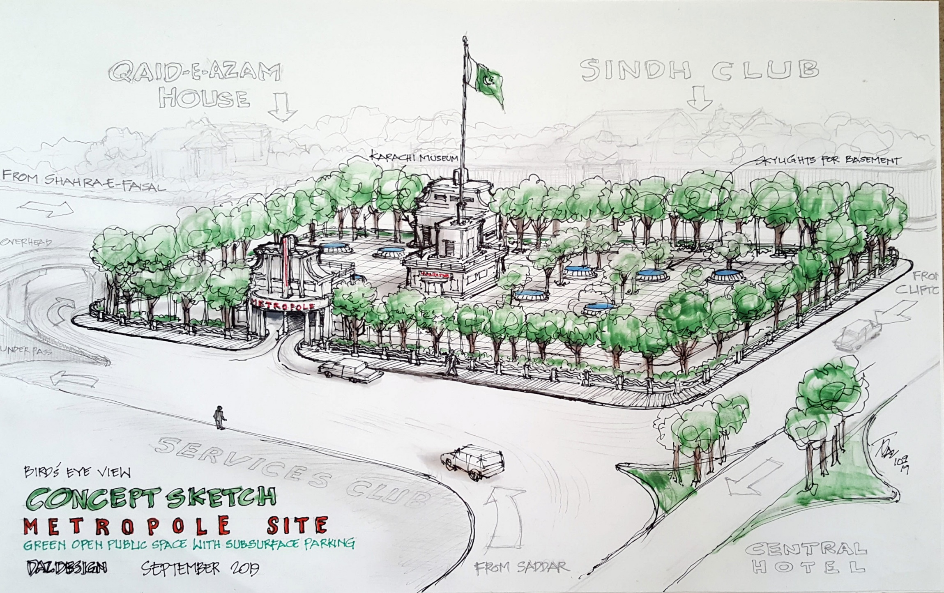
The Shahr-e-Faisal terminates at the Metropole and it would be befitting if a giant flag of Pakistan welcomes all the delegates visiting Pakistan entering the Chief Minister enclave

