Slide 1
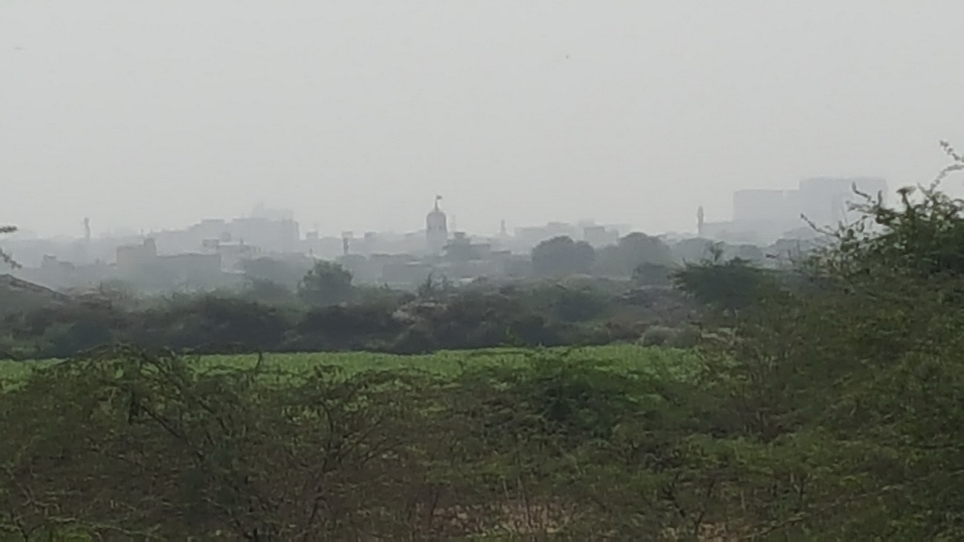
Save
GUTTER BAGHICHA
A Case for
KARACHI ECO PARK and BOTANICAL GARDENS
May 2019
By SHEHRI (Citizens for Better Environment)- DAZ, Karachi

Slide 2
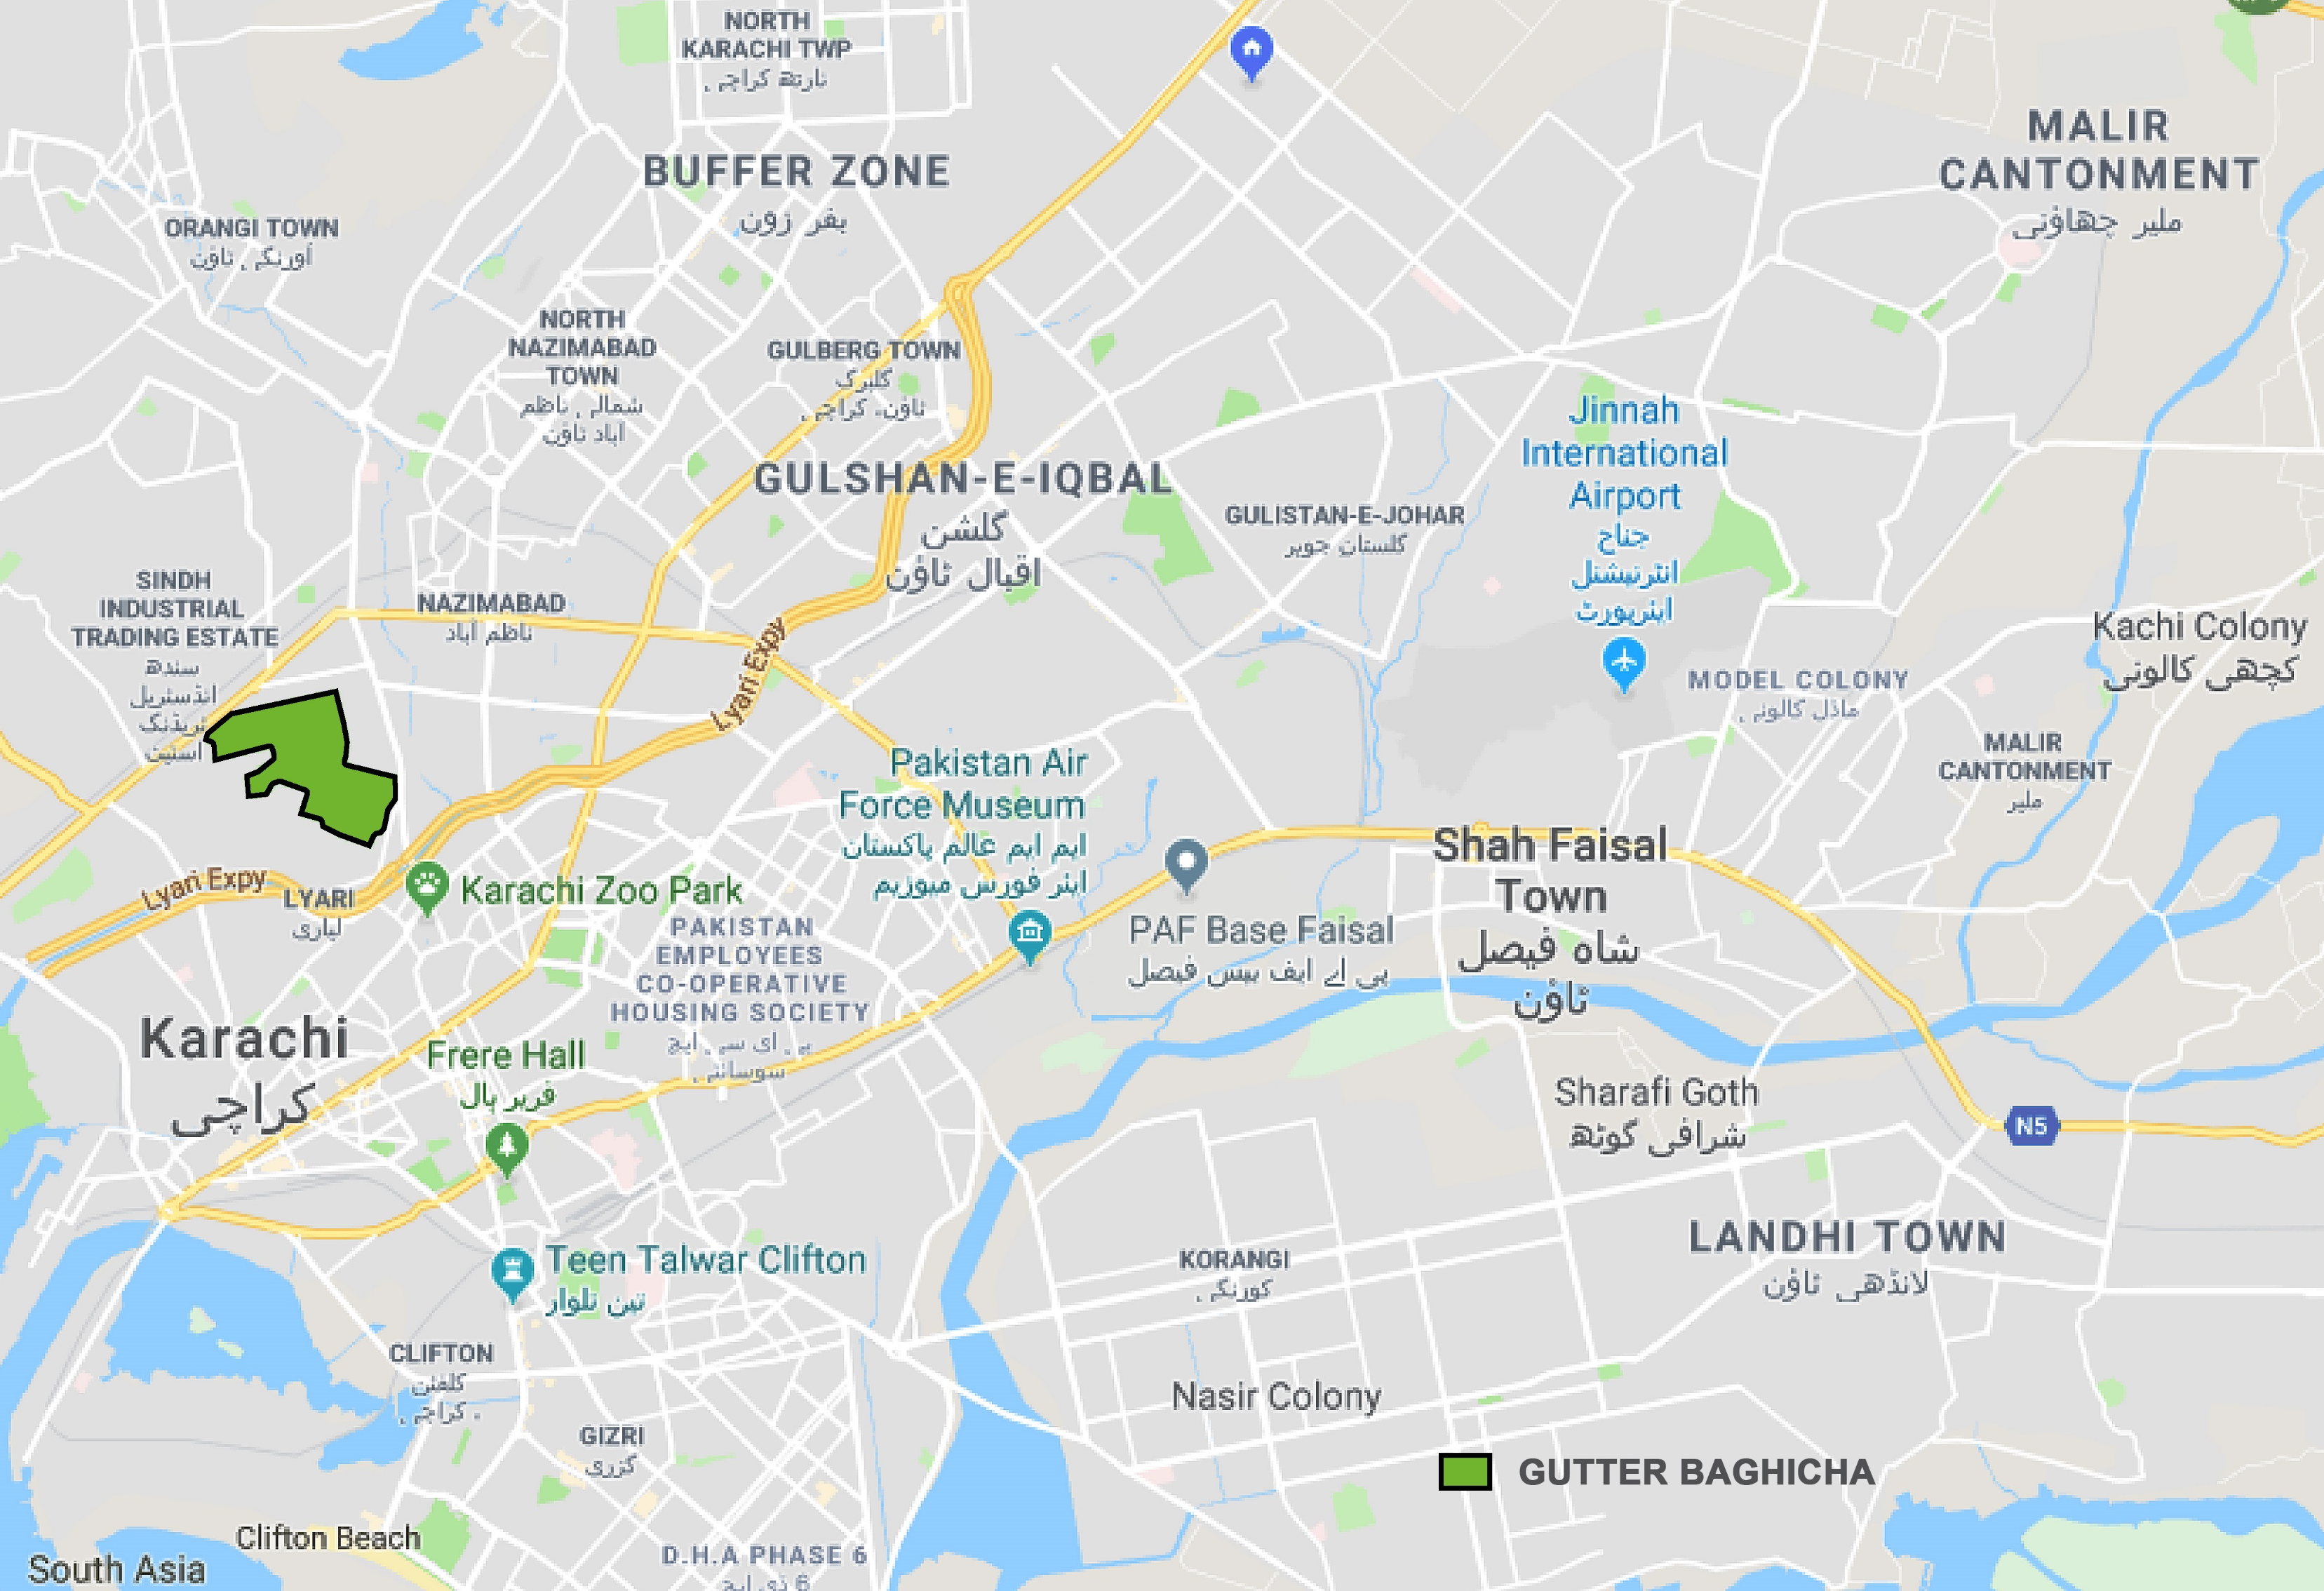
POTENTIAL LUNGS OF KARACHI
Gutter Baghicha is the largest continuous open green space located in SITE Town, along the Mangopir Road, one of the most densely populated parts of Karachi, with SITE Industrial area on the north and Golimar/Mewashah and other graveyards in the south
At the time of Partition the Baghicha was referred to as ‘The largest Urban forest in Karachi’. Apart from the cultivated area there were also large tracts of natural vegetation with abundance of flora and fauna.

Slide 3
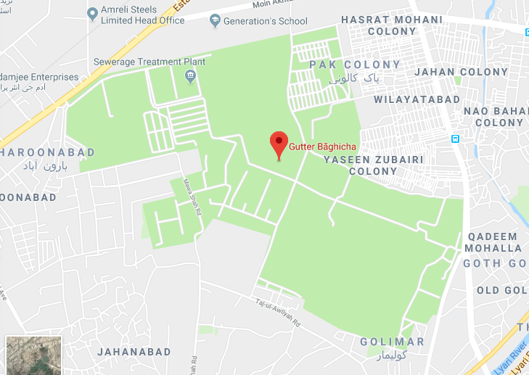
When the British handed over the Baghicha to the Karachi Municipal Corporation the area was approximately
1017 ACRES
The Google maps still shows the area as a Garden

Slide 4
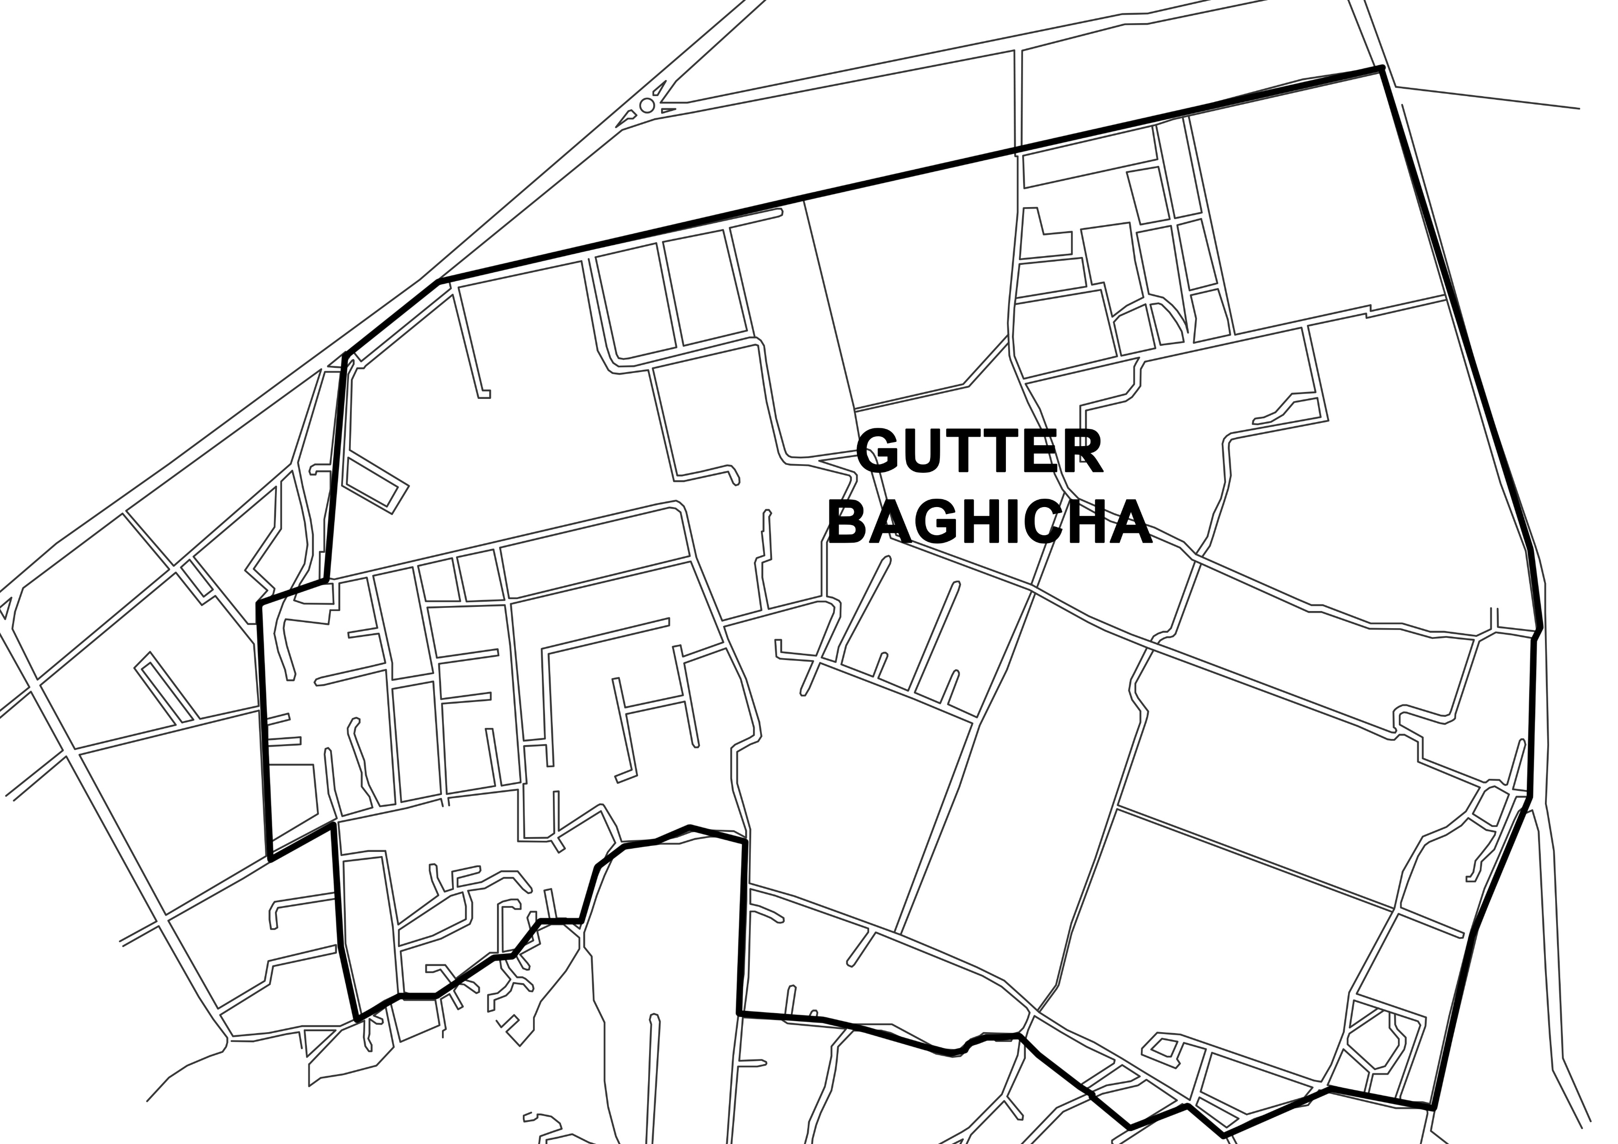
Over the decades the story of Gutter Baghicha has been one of criminal abuse, neglect, land grabbing, encroachment and it has turned into a dumping ground of waste
Dumping Ground of toxic waste from SITE and marble waste from the nearby factories. Large areas have been taken over by Water Tanker mafia and numerous huge plots have been carved up illegally, allotted to various parties, and this abuse continues…..

Slide 5
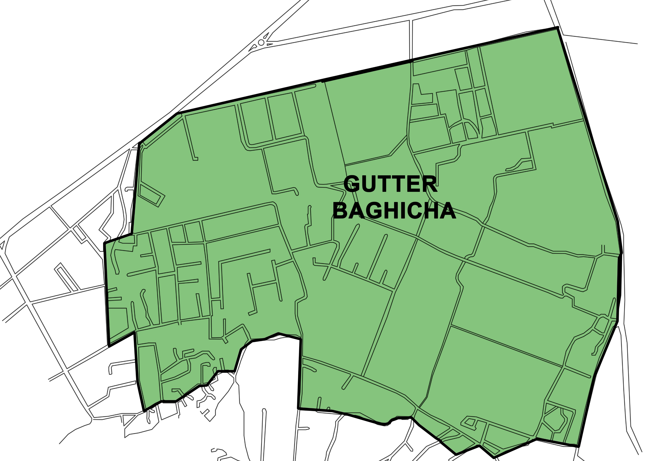
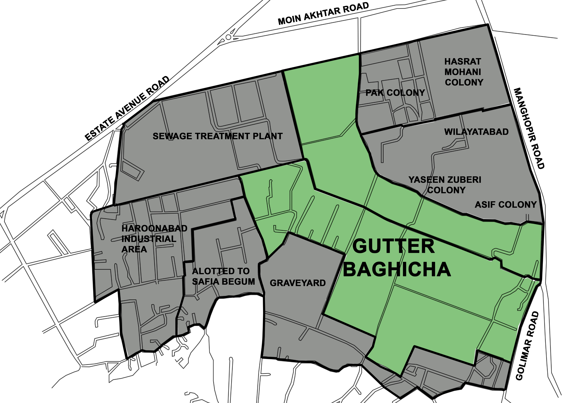
1947
2019

Slide 6

NOT ALL IS LOST - THERE IS STILL SOME HOPE
What is left of Gutter Baghicha is roughly 338 Acres, about 1/3 of the original, but the problem is - it is vanishing a several hundred square yards every year
338 ACRES Proposed
KARACHI ECO PARK and BOTANICAL GARDENS
Huge tracts of land was converted into Haroonabad industrial area, plots given away illegally to various bidders. In the south the graveyards kept expanding unhindered with areas allocated to various ethnic communities. A large portion was designated for the Sewage treatment plant (TP1). This can be retained and made functional
TIME FOR ACTION

Slide 7
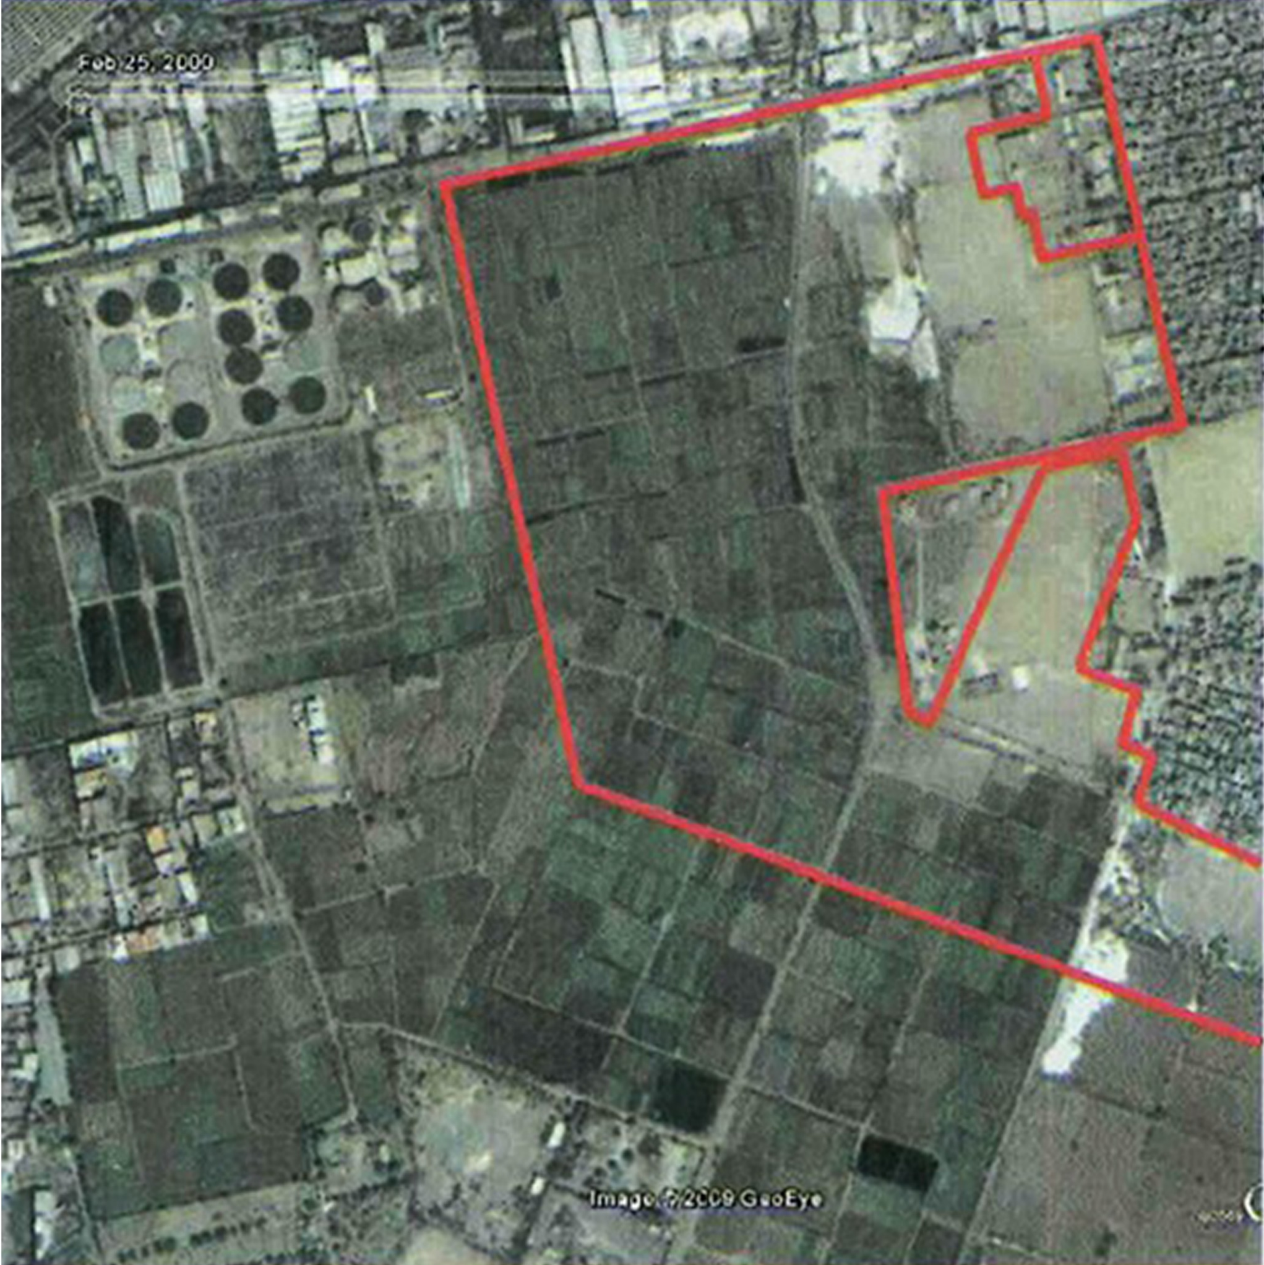
In 2002 the Satellite pictures of Gutter Baghicha showed vast rented Farms and open spaces

Slide 8
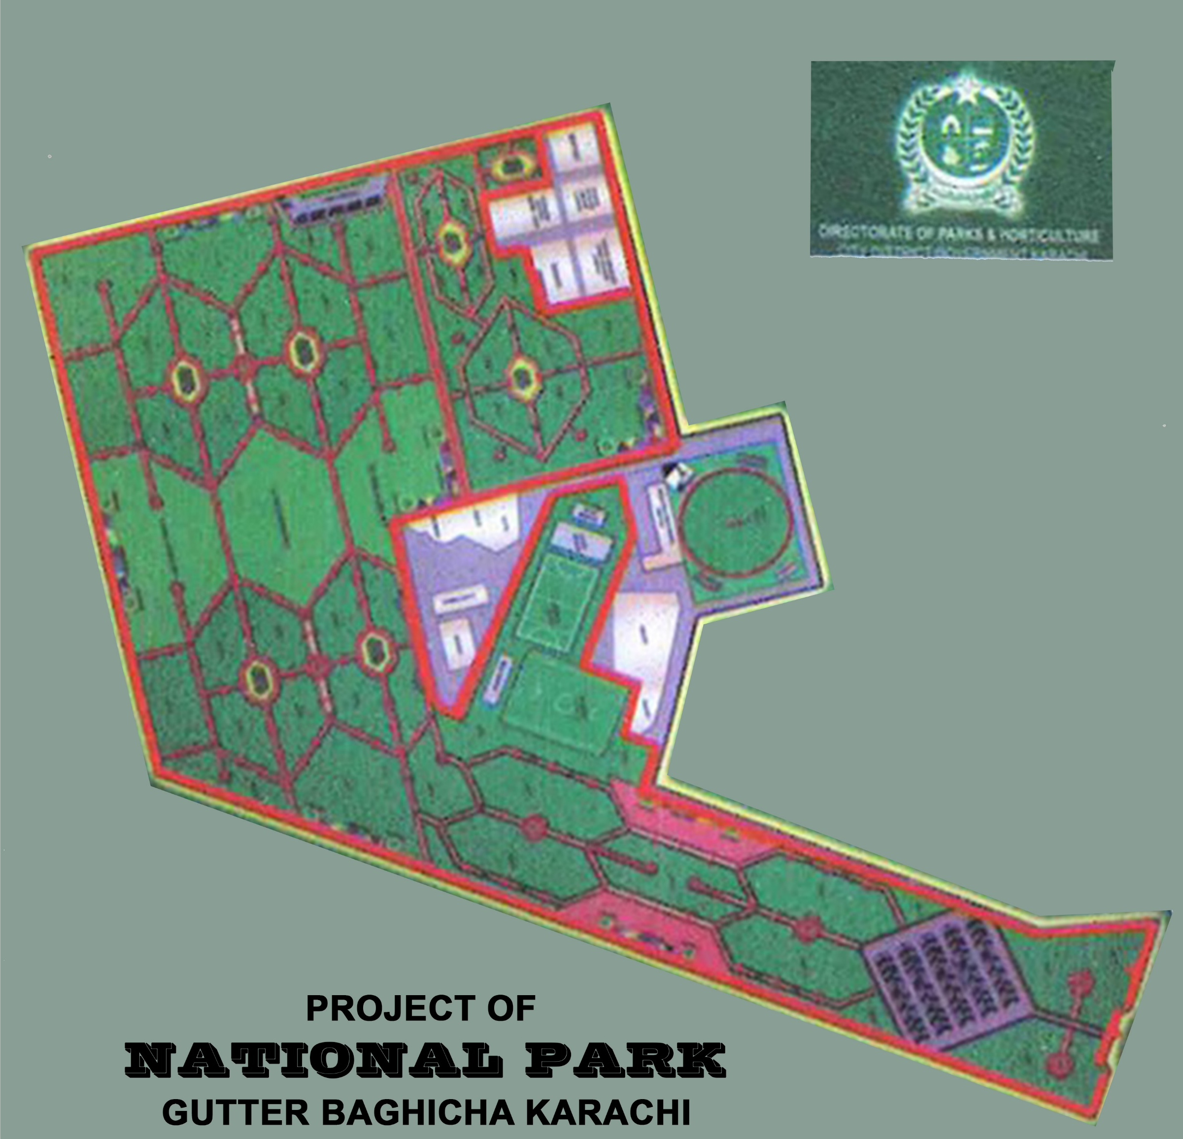
In 2005 an attempt was made by the Local Government to convert the remaining portion of the Baghicha into a park

Slide 9
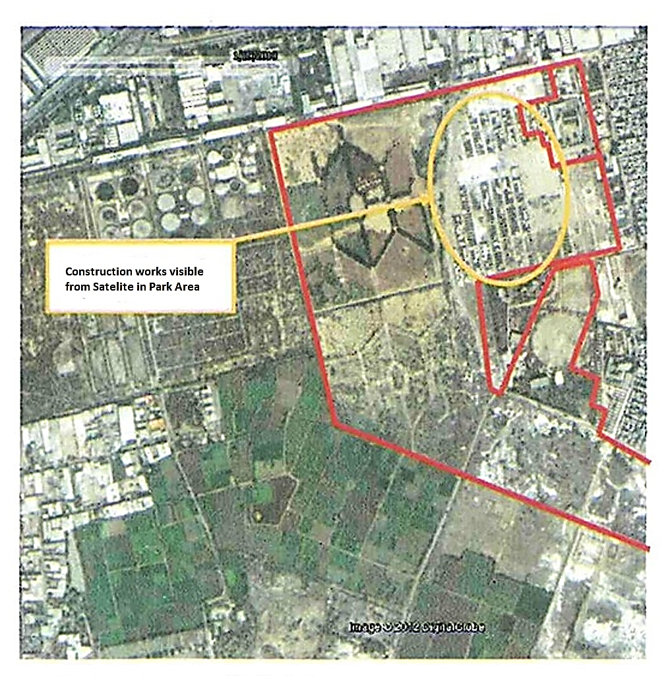
A lot of undesirable ‘Conocarpus’ trees were planted in some areas but soon enough the planned park space was being encroached upon

Slide 10
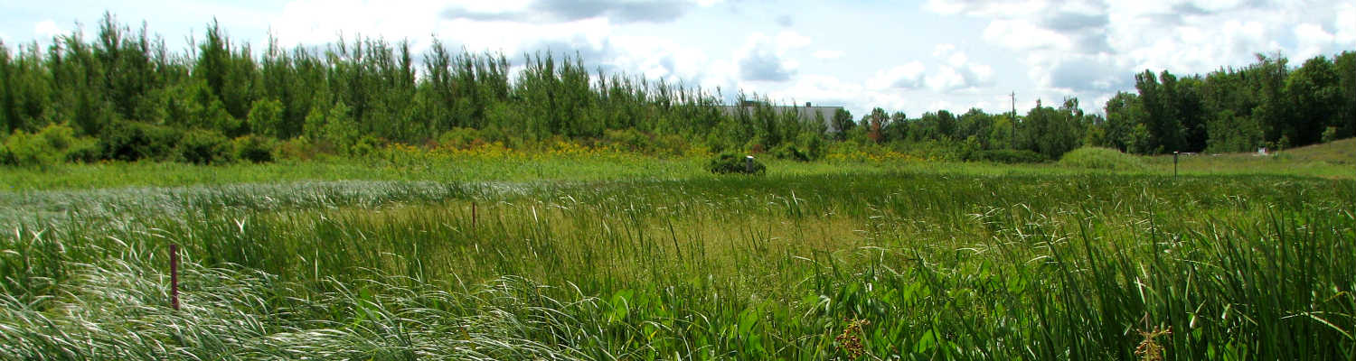
TIME IS RUNNING OUT
We are all aware of the looming Ecological disaster, the Climate Change and its horrific effects that do not respect geographic boundaries
We are also well aware of the solutions provided by Nature and well within our reach
PAKISTAN SHOULD PLAY ITS PART IN THE ECOLOGICAL RESTORATION
AFFORESTATION
Trees and Urban forests are one of the best ways of capturing the deadly Carbon dioxide and other pollutants. In return the forests clean the air and provide us Oxygen

Slide 11
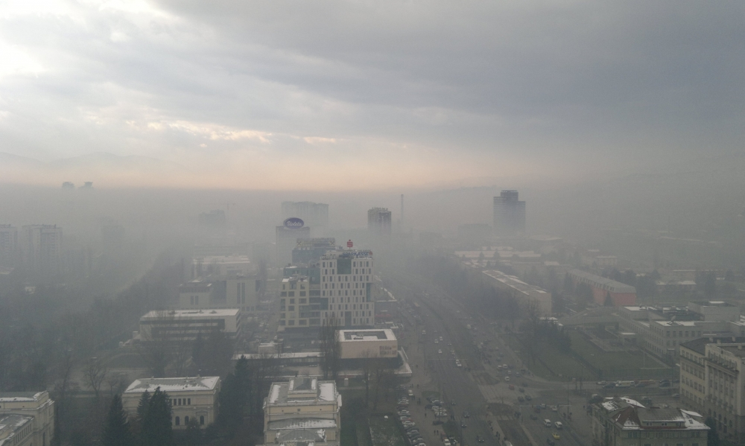
The effects of Densification of Urban centers, Pollution and Environmental degradation on Global health is highly underestimated
“One in four individuals suffers from mental illnesses or disorders. By 2020, depression will become one of the leading causes of death across the globe.” (Prof. Malik Mubbashir. March, DAWN
About the ‘Heat Island Effect’ in Karachi where over a thousand people died when the temperature wet up to 42 degrees Celsius for 6 days in 2015.
(No Country can ignore the impacts of climate change, May 5th, DAWN}

Slide 12
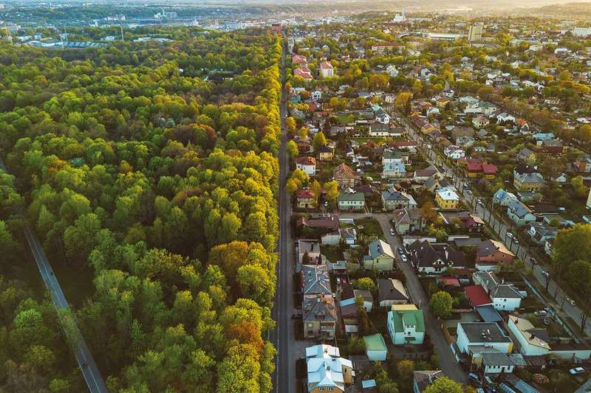
There is a talk of a long term-term forest policy in Pakistan, and a program of ‘Billion Trees’ in the pipe line by the government. This is a good sign but there is an pressing need for
URBAN AFFORESTATION
Gutter Baghicha presents a unique opportunity in the GREENING OF KARACHI and to create a first mega
Eco Park and Botanical Garden
A sample Green city

Slide 13
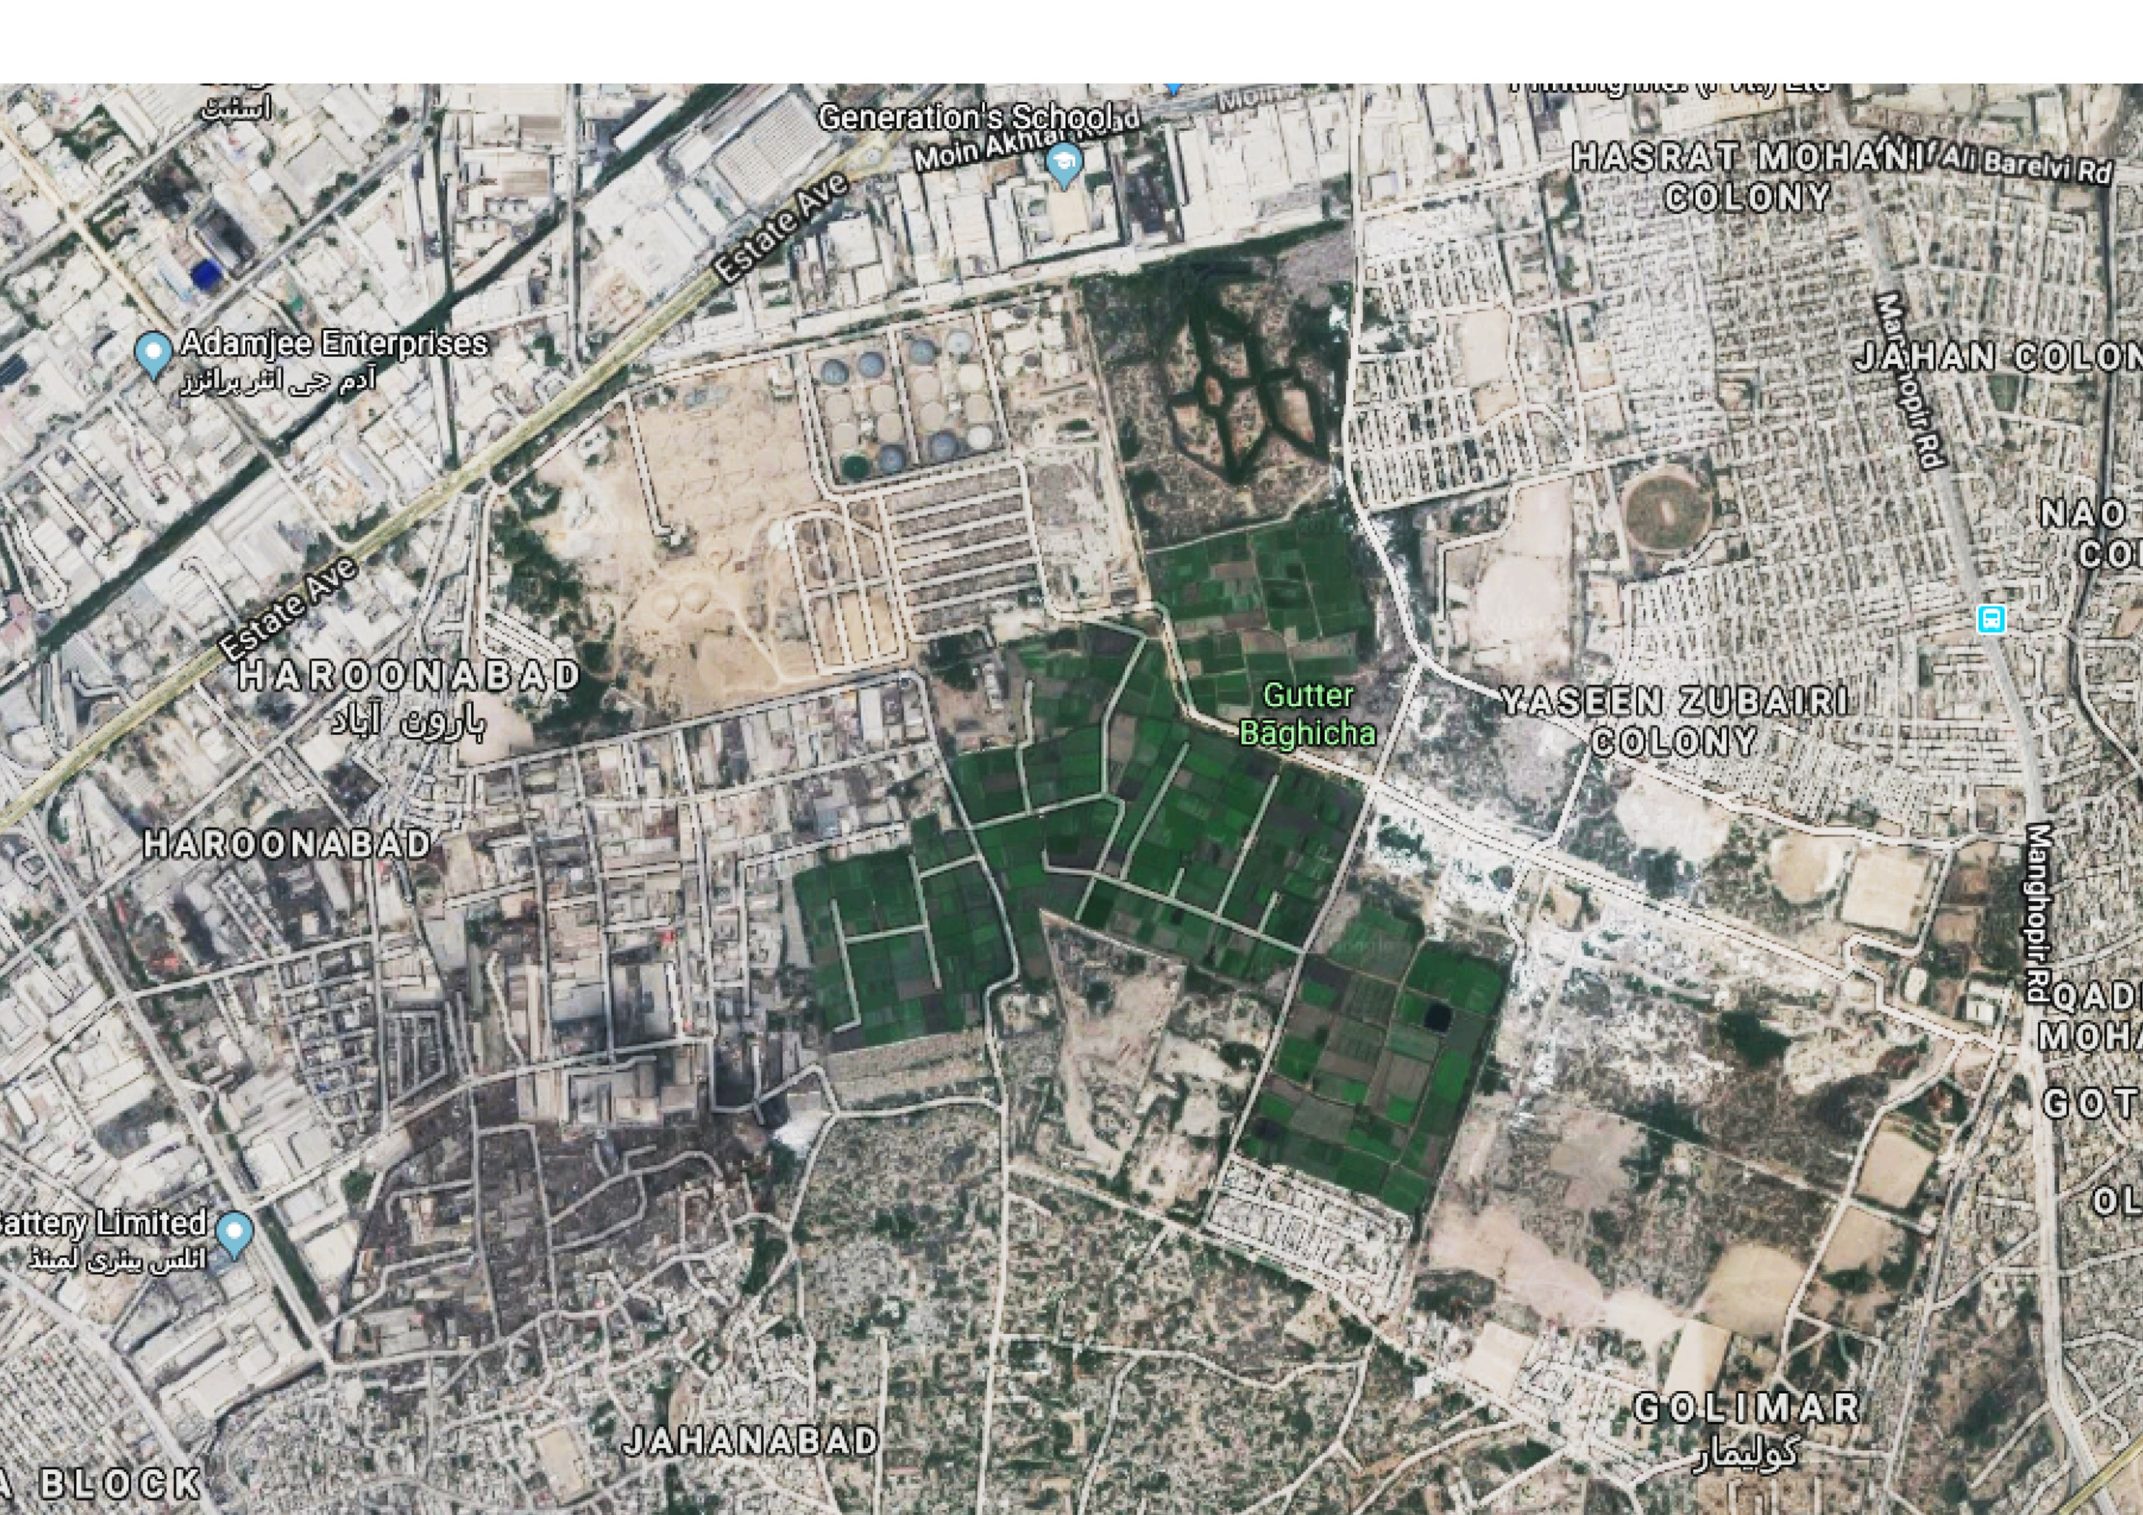
One can still see a large portion of Baghicha, which is the most fertile land in Karachi. It still has a great potential for the recreation starved citizens of Karachi, if we can save it from further abuse and degradation

Slide 14
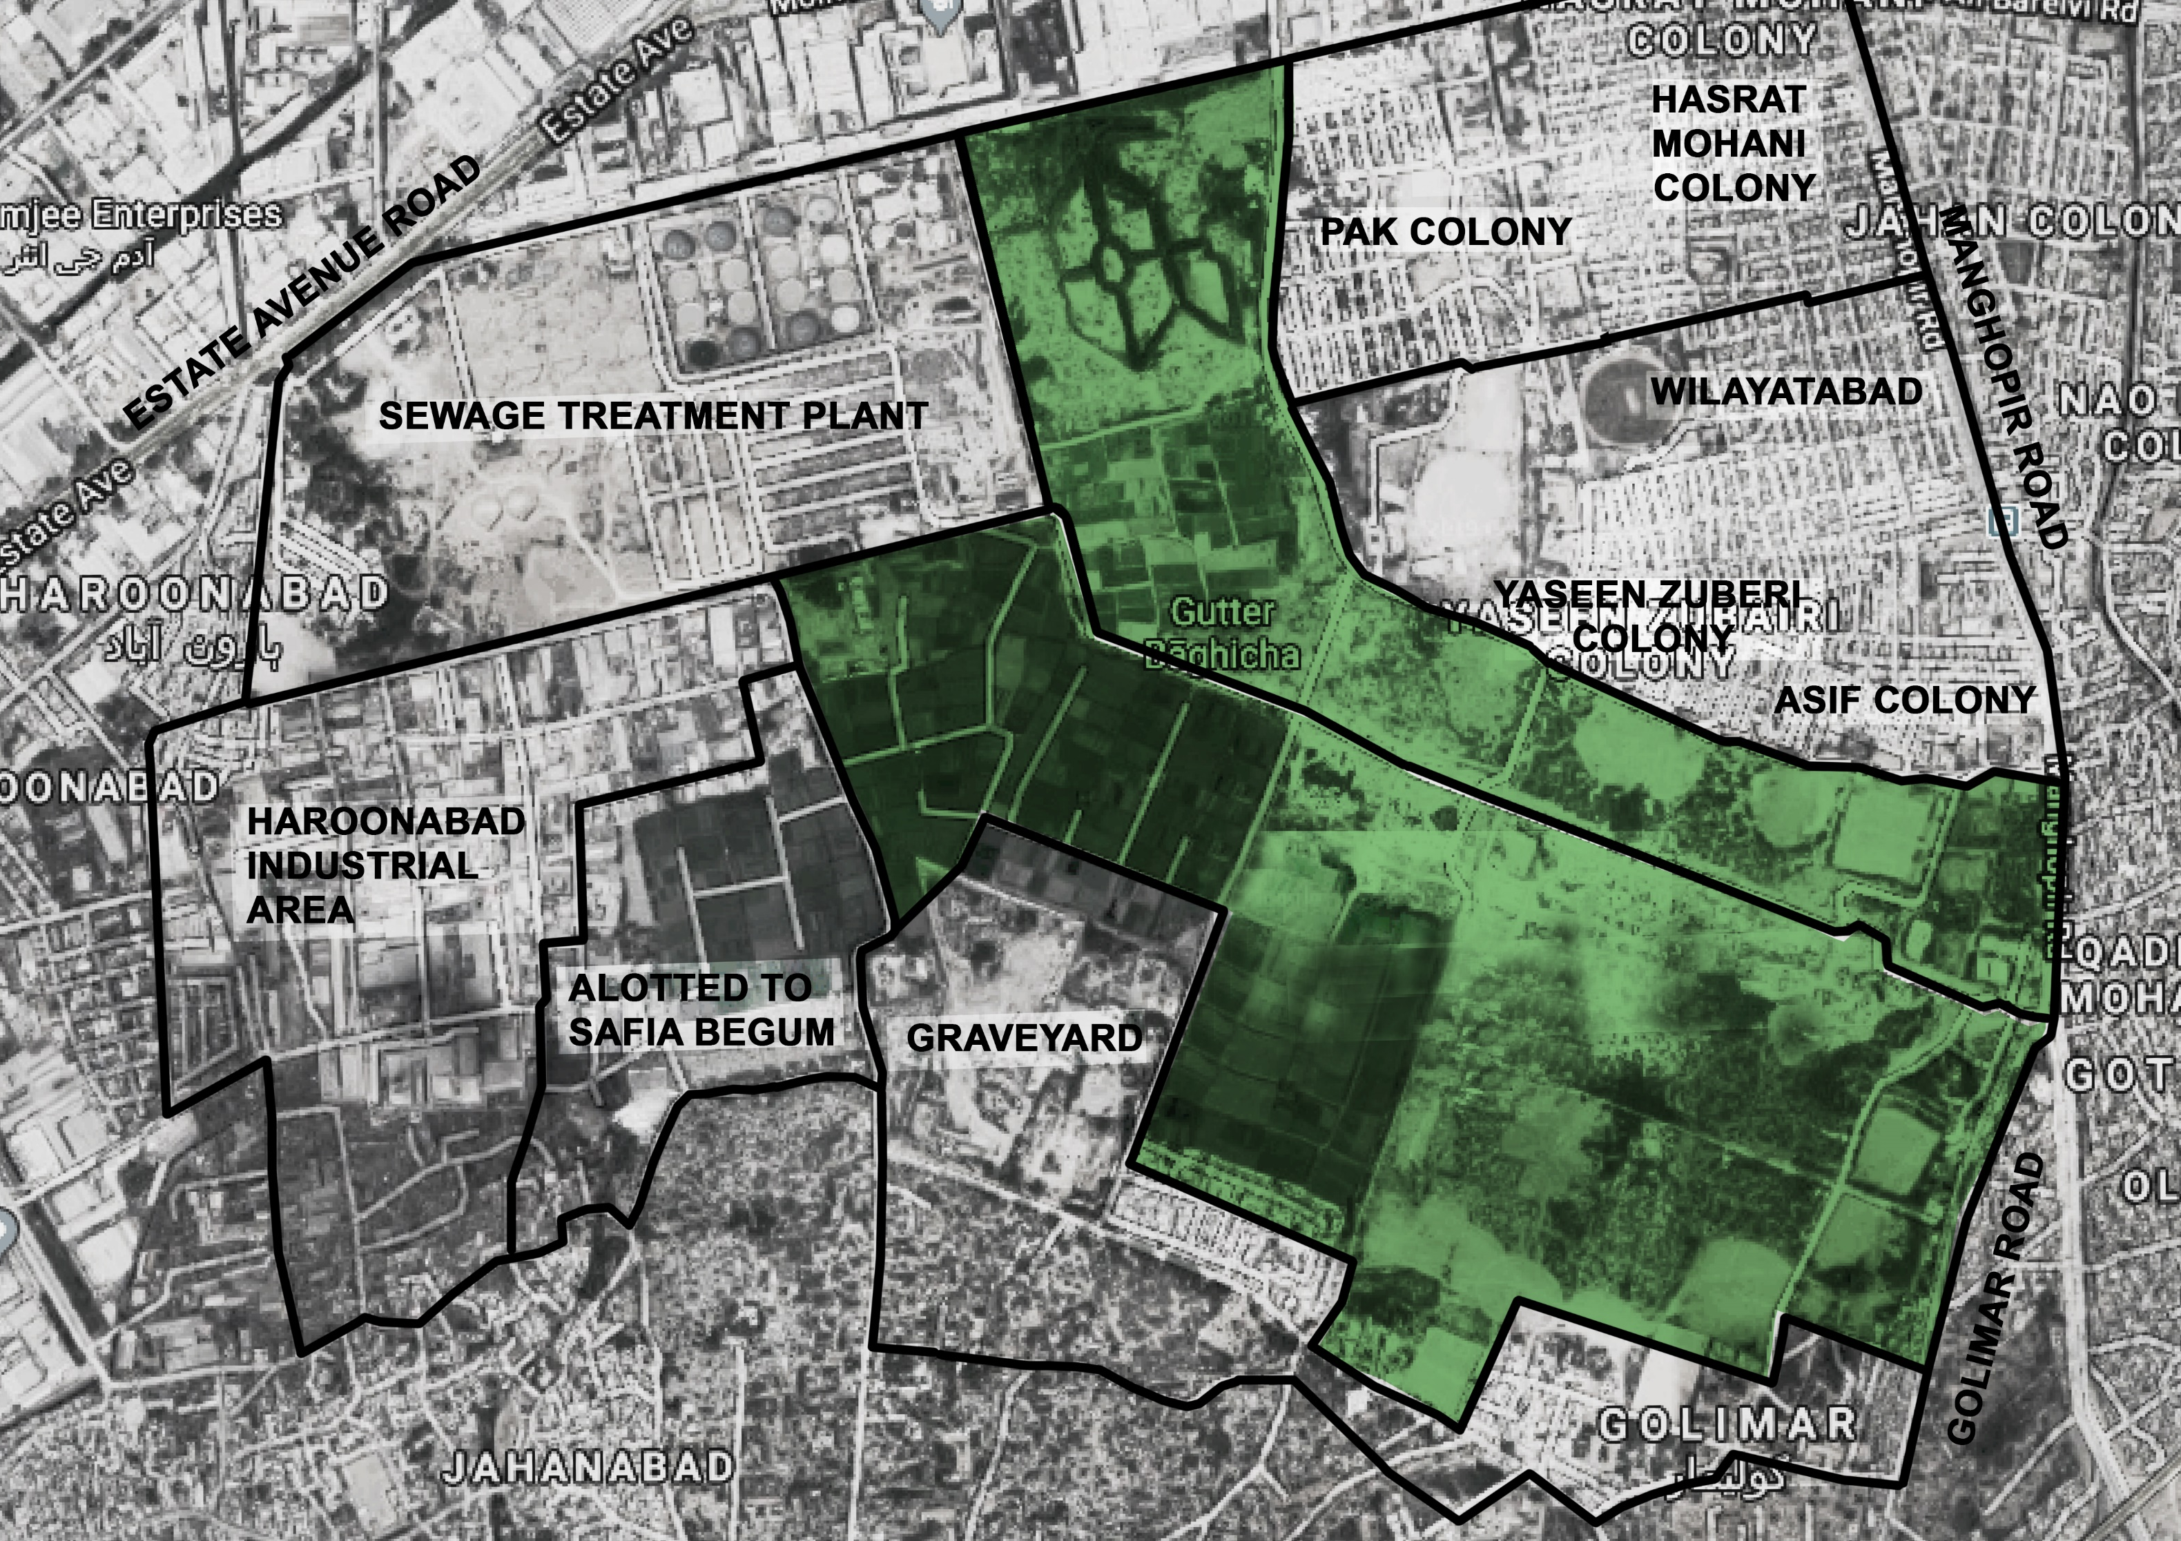
It is proposed by Shehri to cordon off and ‘lock’ what is left of the Gutter Baghicha to save it from further encroachment
“KARACHI ECO PARK and BOTANICAL GARDENS”

Slide 15

Since the last two decades SHEHRI (Karachi based an NGO) has been trying to save this vital public space from encroachment and destruction and develop it for its citizens and posterity

Slide 16
Gutter Baghicha can be turned into a beautiful Nature reserve with design interventions and extensive Greening
KARACHI ECO PARK and BOTANIOCAL GARDENS can start ECO-TOURISM. It will serve both Recreational and Educational purposes. It can be made Self-Sufficient by generating its own revenues from Fruit and Vegetable farming
This can be a real gift for the people of Karachi, especially for the bastis and neighborhoods of the Baghicha who live in unhygienic and pollution laden environment. People living in Lyari and all the adjacent areas – they have no recreation facilities and they live with a sense of deprivation. Imagine what a peaceful green park in their midst would do for their psyche, health and law and order

Slide 17
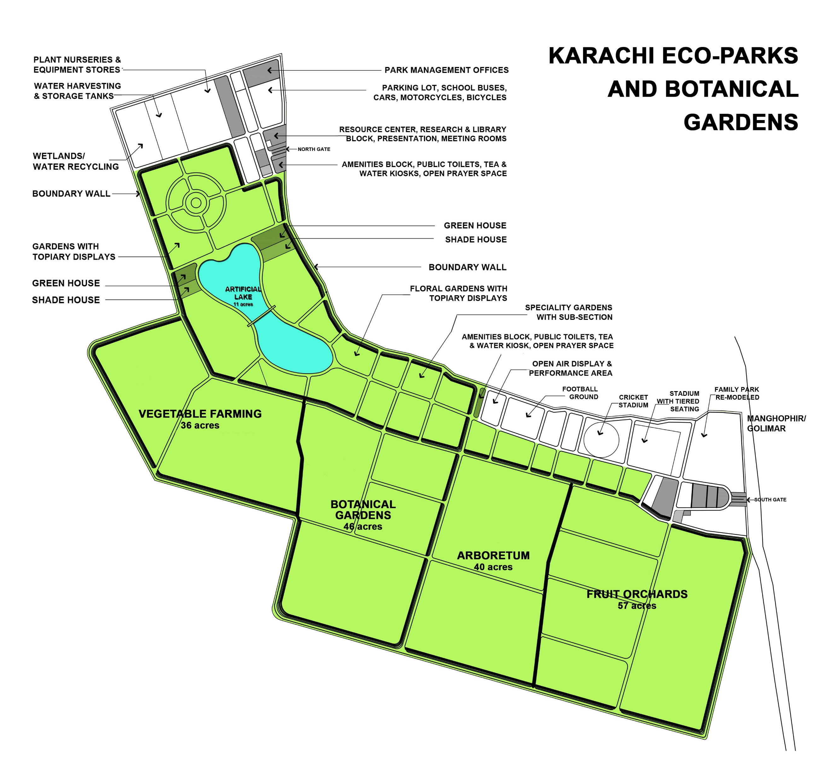
A preliminary Concept Plan was created by DAZDESIGN Consultants in January 2019

Slide 18
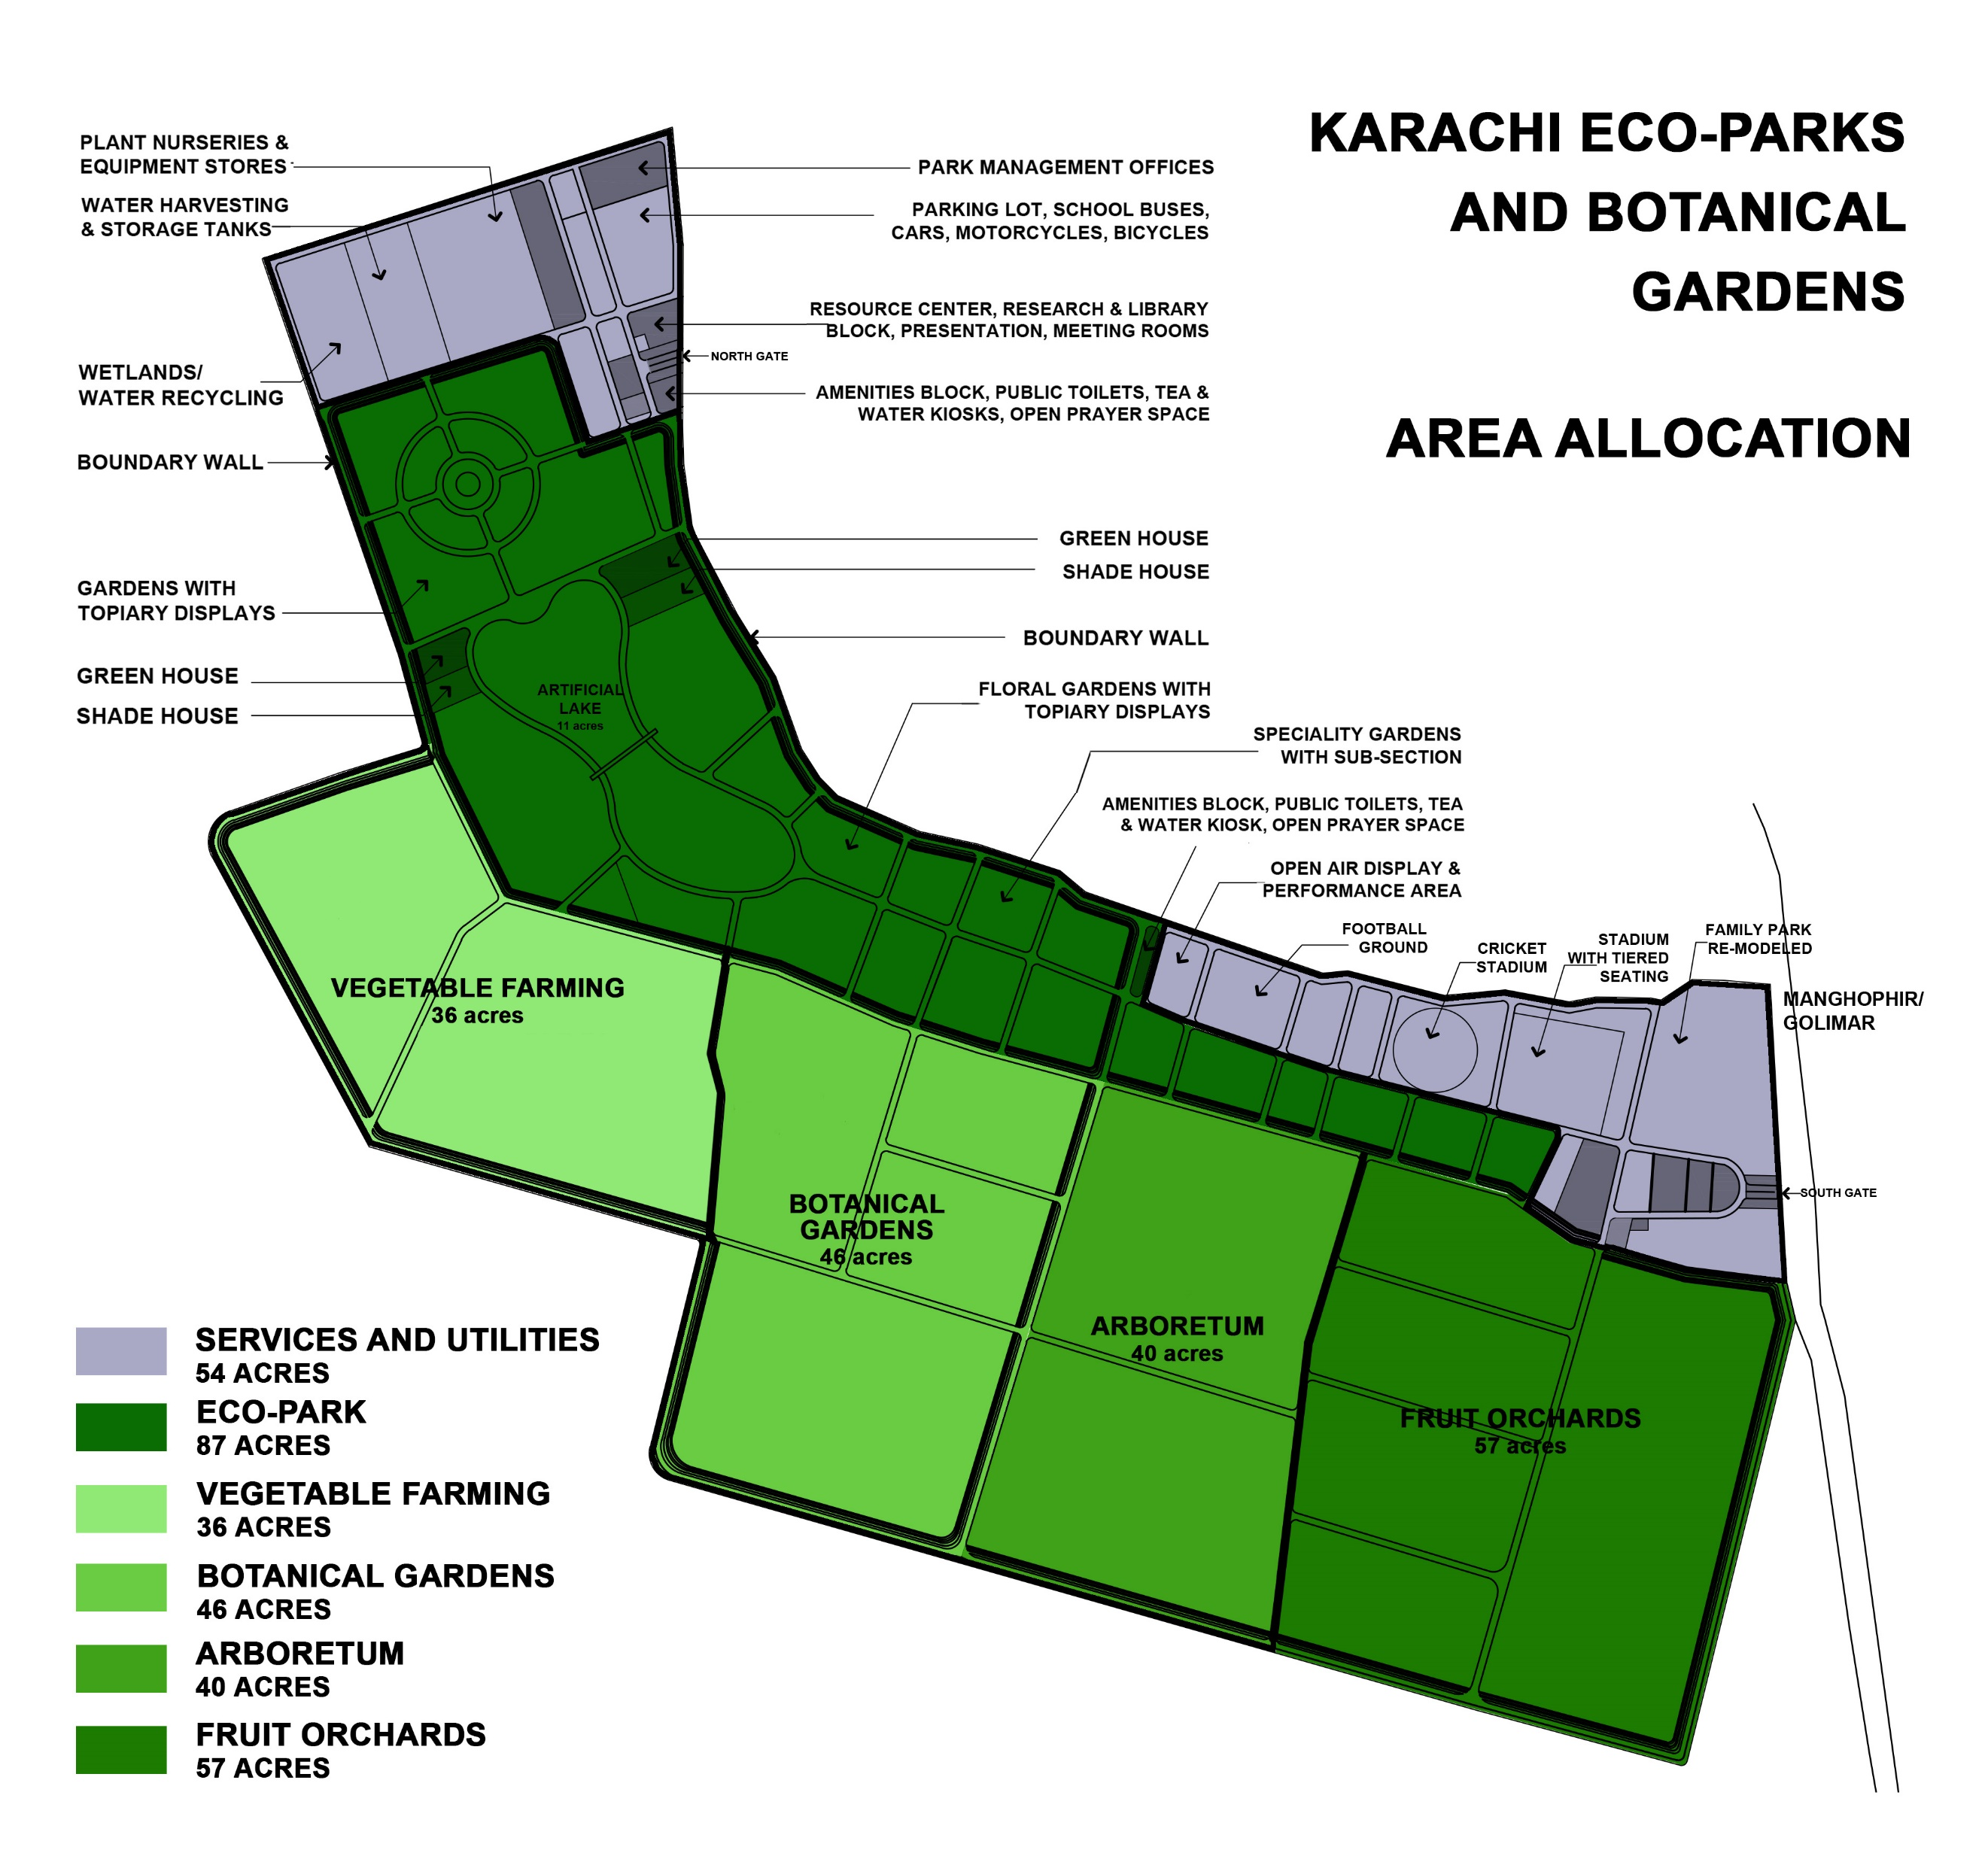

Slide 19
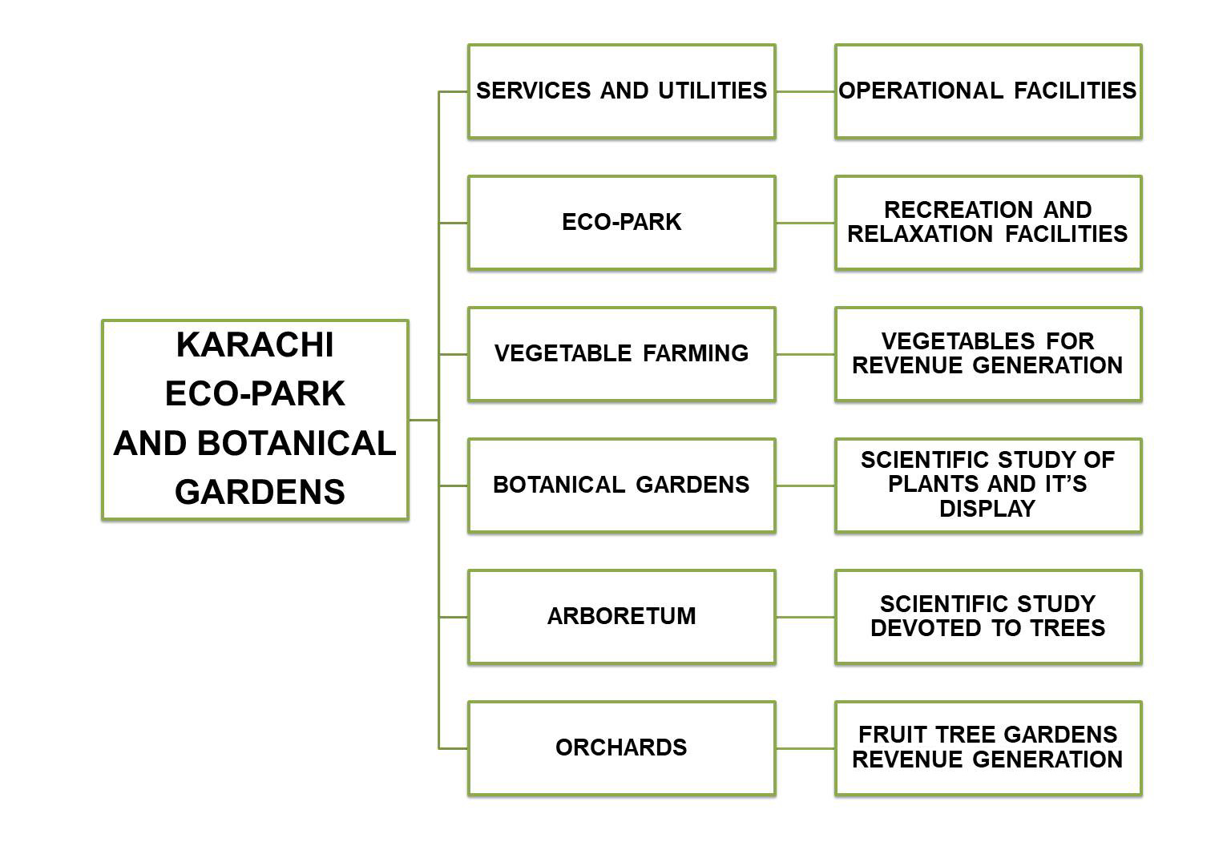
MANAGEMENT

Slide 20
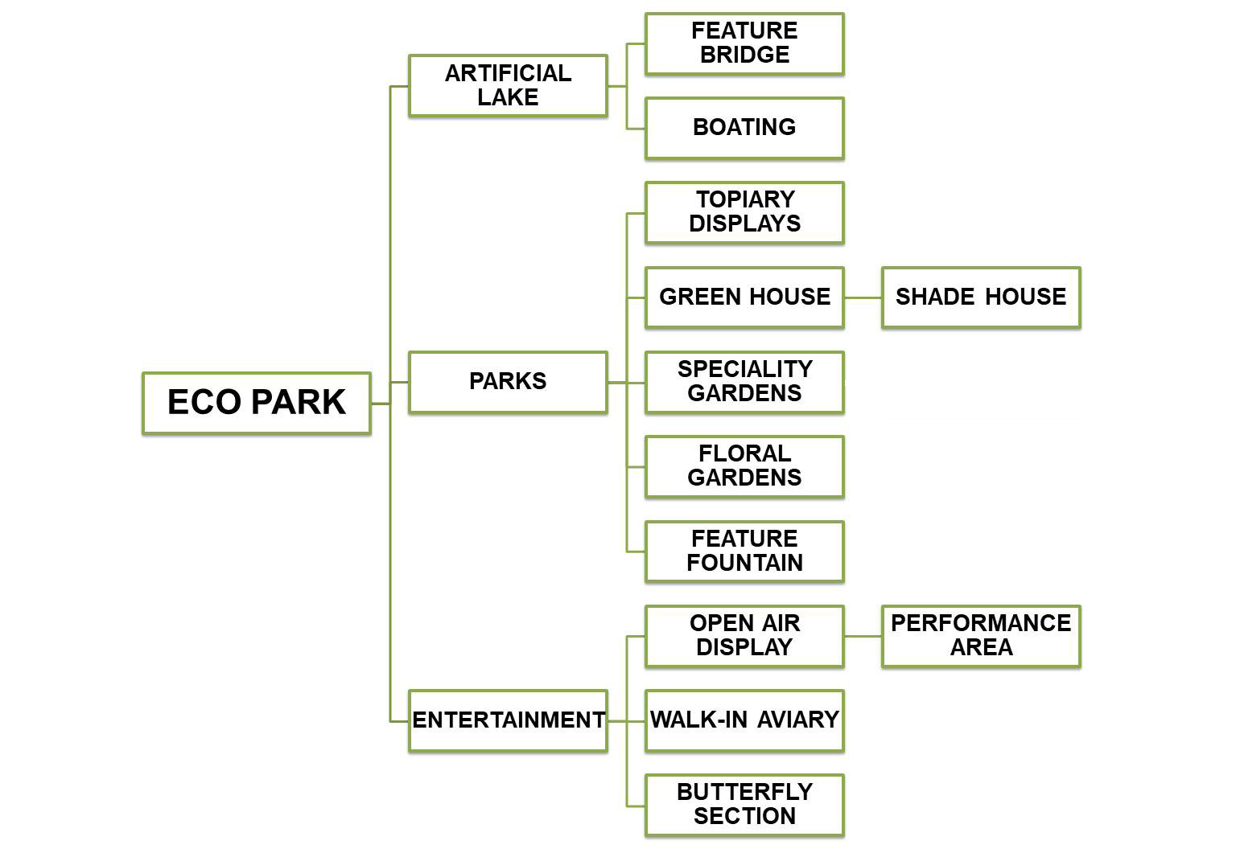

Slide 21
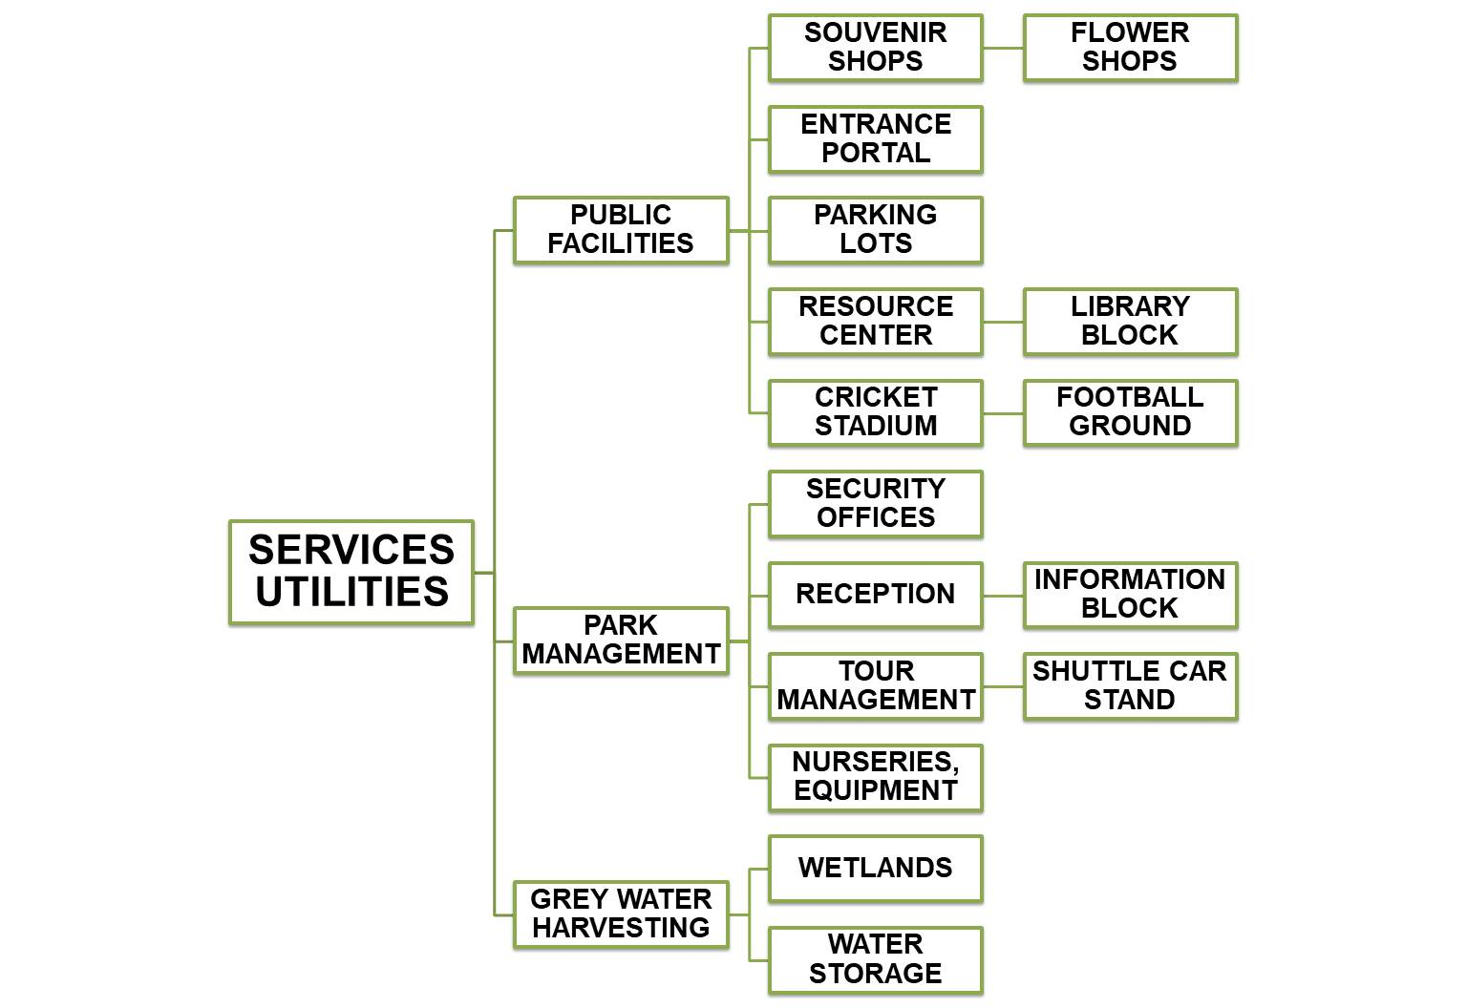

Slide 22
DESIGN PHILISOPHY
It is proposed that DESIGN interventions follow an overarching principle of Environmental and Eco Friendly materials and Technologies
ENERGY requirements should be met by non-grid, renewable energy solutions like Solar or Wind or alternative solutions
WATER requirements will be fulfilled by Sewerage Treatment plants products, artificial Wetland and ground water pumping
For CONSTRUCTION unconventional technologies and materials will be introduced
LOCAL COMMUNITIES especially the females will be offered employment opportunities for building programs with waste products, plastic bottles and household refuse
REDUCE-REUSE-RECYCLE

Slide 23
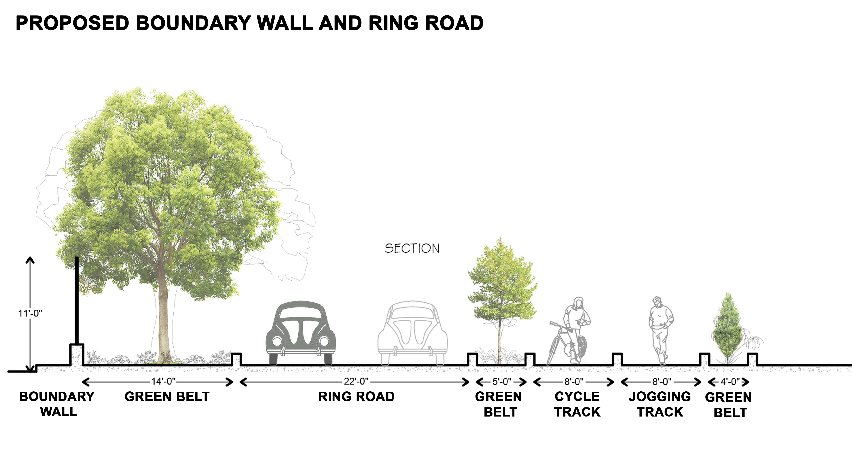
BOUNDARY WALL and possibly a RING ROAD with green belts should become the first priority
A concrete and steel boundary wall (6 Kilometers long) has very high Carbon footprints, the cost of which is calculated at approximately 150 Million Rupees. This can be built with Green technologies and materials like HEMPCRETE and Bamboo and can bring down the cost to less than ¼

Slide 24
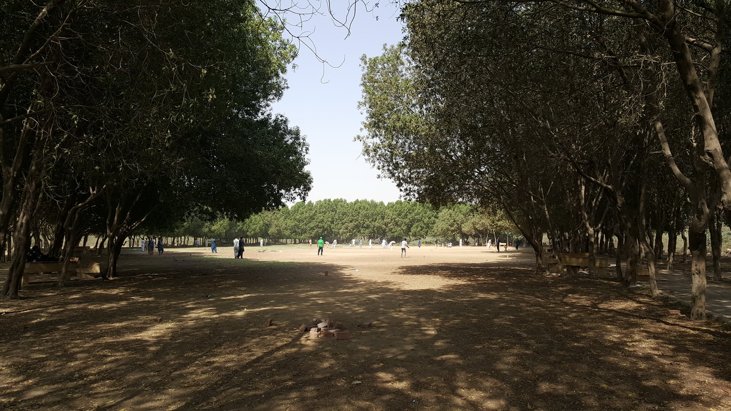
Some snap shots of existing Gutter Baghicha
There is still a lot of land that can be turned into lush green Garden

Slide 25
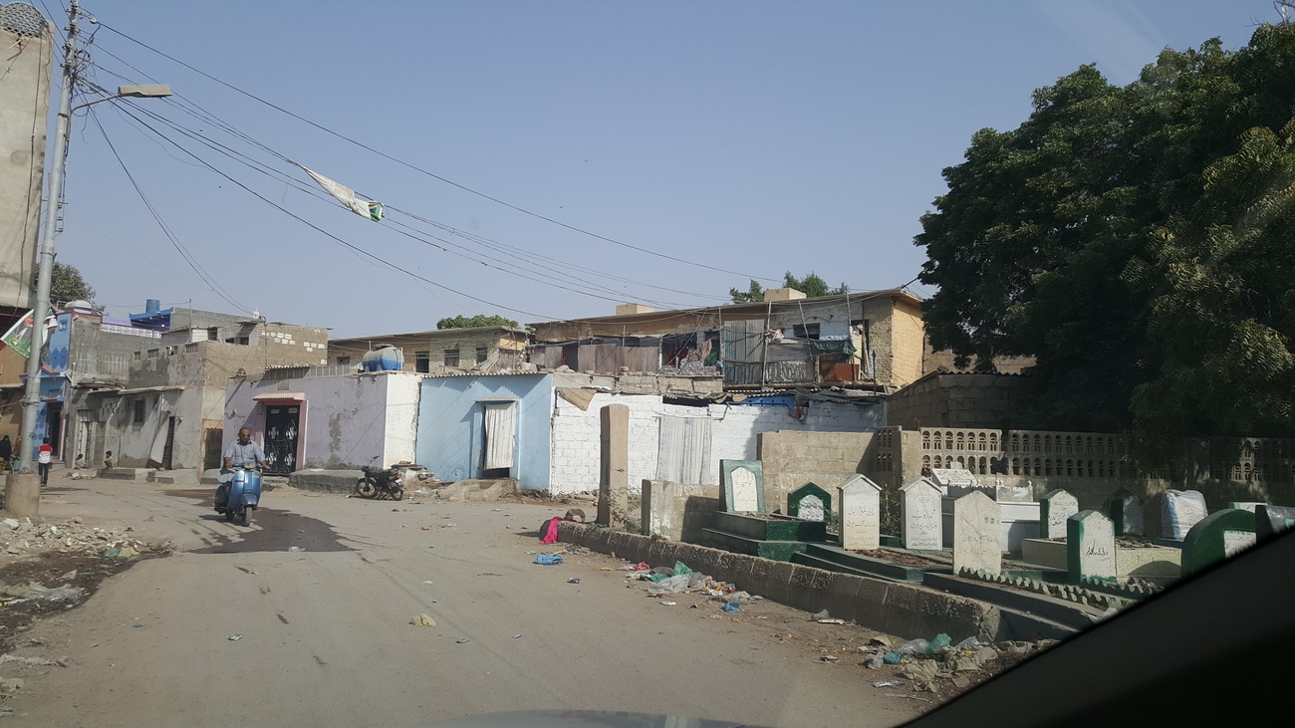
The encroaching graveyards that disregard housing boundaries have to be organized

Slide 26
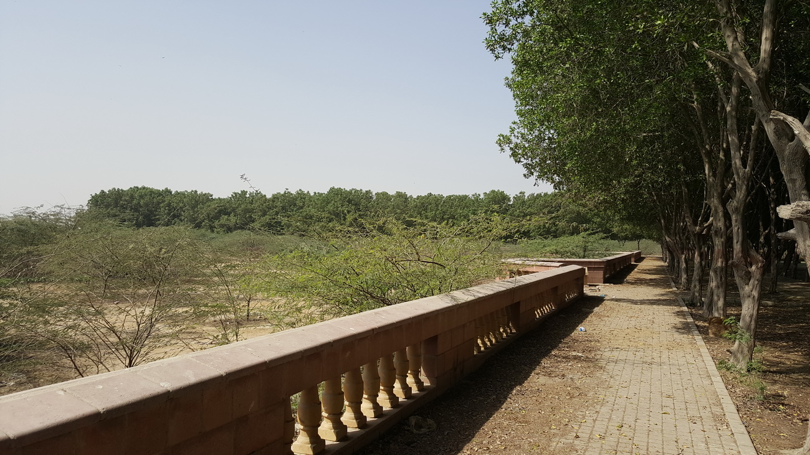
Some existing materials can be salvaged and used in the new Design scheme

Slide 27
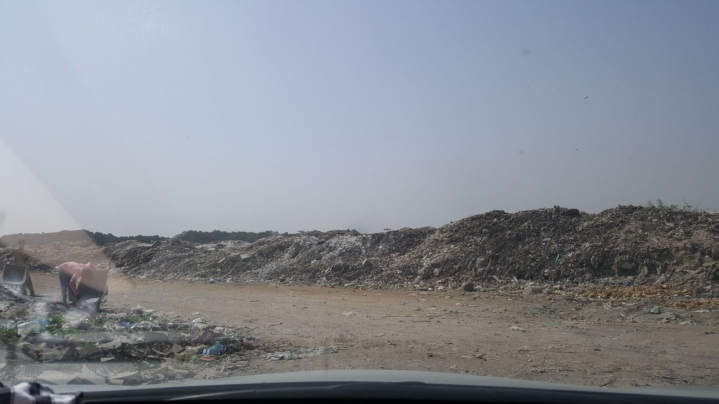
Huge mounds of garbage will have to removed to clean up

Slide 28
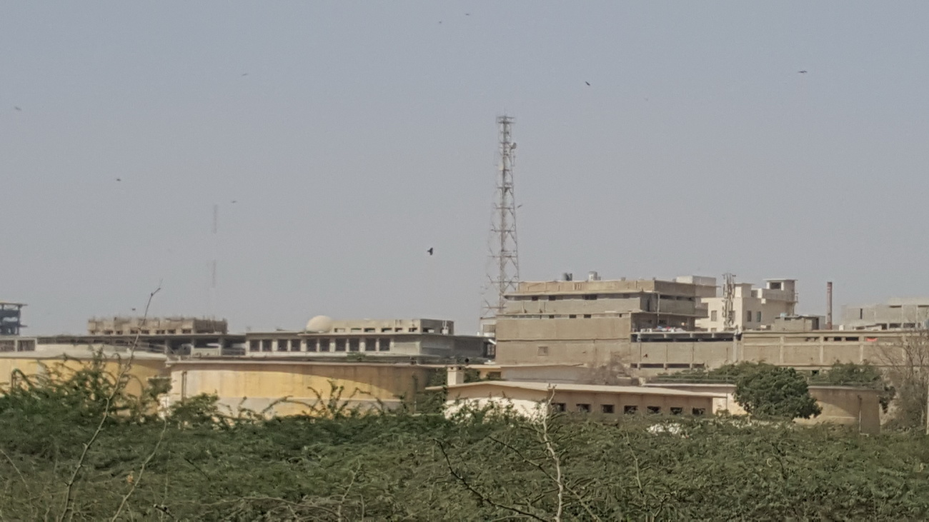
The first Sewage treatment plant of Karachi which is laying barren can be rejuvenated and made functional

Slide 29
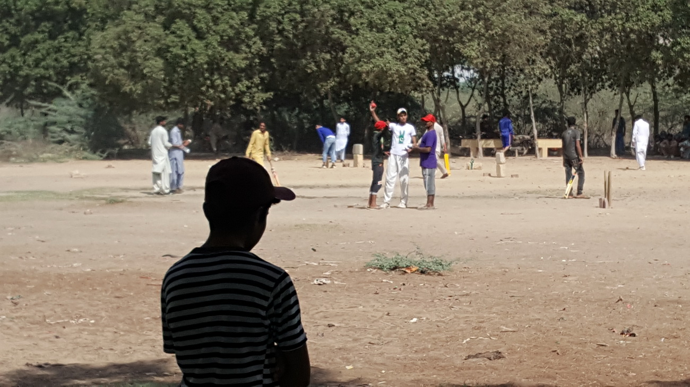
All the playgrounds within the jurisdiction of Gutter Baghicha can be organized and uplifted

Slide 30
KARACHI ECO PARK and BOTANICAL GARDENS
Shehri will constitute a Shehri TRUST for ‘Greening of Karachi’ from among its Members and by invitation. The Steering committee of the Trust will be responsible for the implementation of the project. It will organize and invite various stake holders, design consultants and contractors to plan and phase out the project. It will coordinate with the relevant Government departments for legal frame work. It will be managed as a Public-Private project. It will organize and raise funds, donations from Corporate sector, private citizens and the Government of Pakistan for the completion of the project.
Let this be a new beginning for
Gutter Baghicha
Thank You

